Slide 1
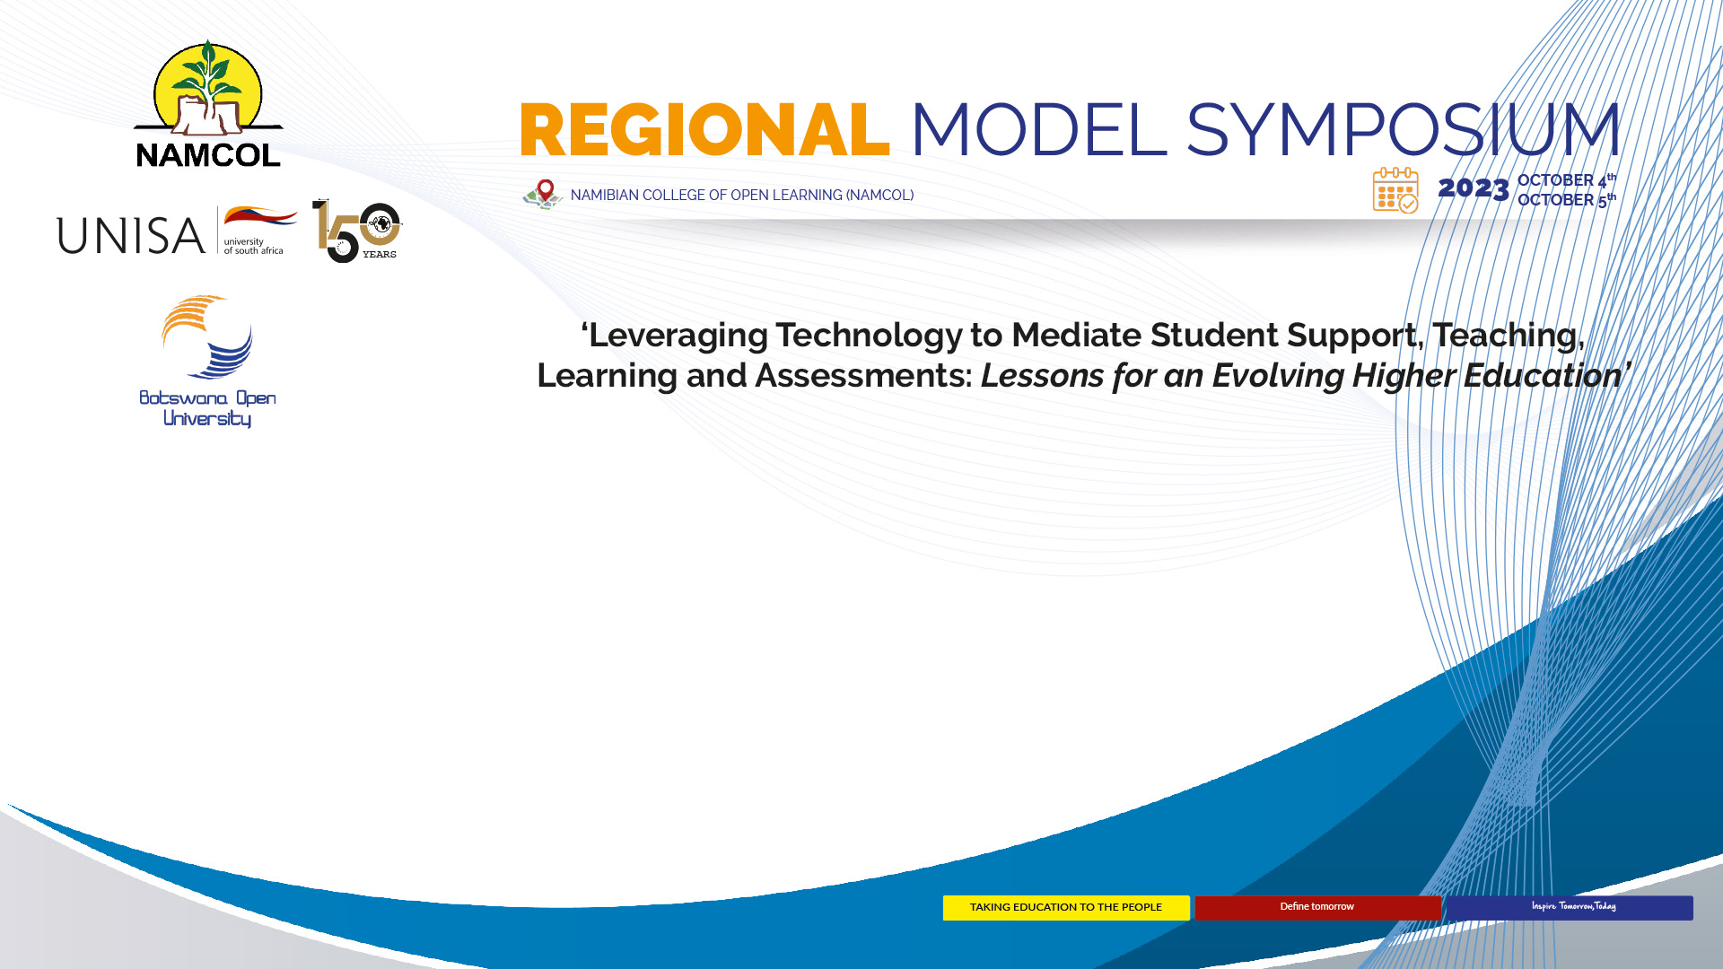
Digitalisation in Higher Education: Systemic Imperatives for Effective Educational Technology Integration
Prof Dr Philip Uys
Senior International Education Consultant
Adjunct Associate Professor Education, University of Adelaide, Australia
http://www.globe-online.com
https://www.linkedin.com/in/philipuys
http://www.globe-online.com/mikeandphilipjointpublications

Slide 2
BACKGROUND
IT career in SA; 7 years senior lecturer in NZ in adult education and did Phd; 18 years in Botswana and Australia as director of educational technologies, learning resources development and learning spaces; emerging educational consultant career since 2000 of more than 20 assignments, in 16 countries, including Botswana (BOU and UB), for various funders. More info http://www.globe-online.com

Slide 3
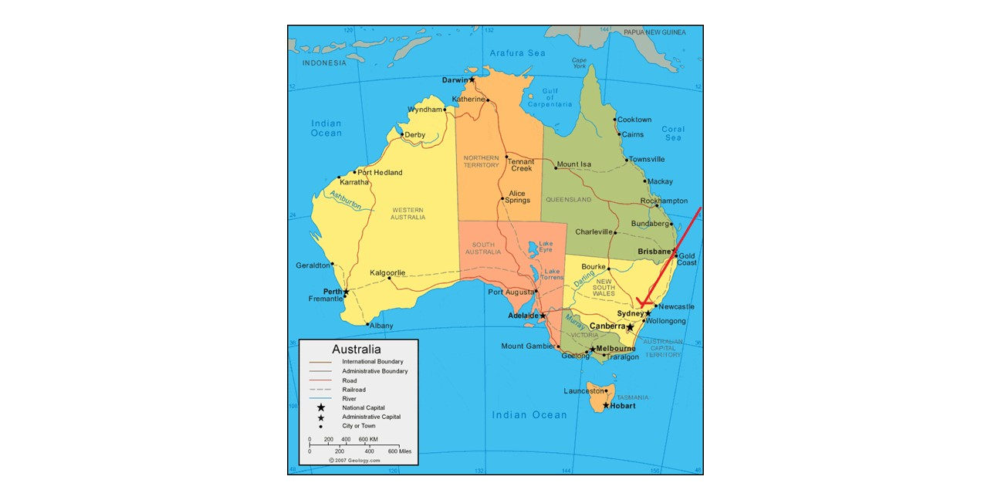

Slide 4
INTRODUCTION
Not digitalisation (systemic integration of ed techs) for the sake of digitalisation

Slide 5
EdTech is not the big idea - it needs to enable and support big ideas
(Prof Mark Brown, National Institute for Digital Learning, Dublin City University, Ireland. Ed–Media Conference, 2019)

Slide 6
Educational technology by itself is not “education's silver bullet” but should be located within “the essentials of teaching and learning: theory, pedagogy and emergent trends in the research.” (Veletsianos & Moe, 2017)

Slide 7

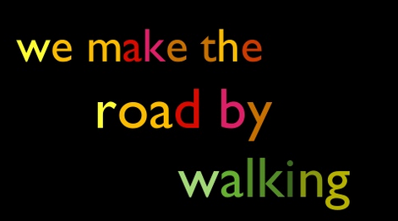
(Horton, M. & Freire, P., 1990)
https://bushwalkingvictoria.org.au/why-is-bushwalking-good-for-you

Slide 8
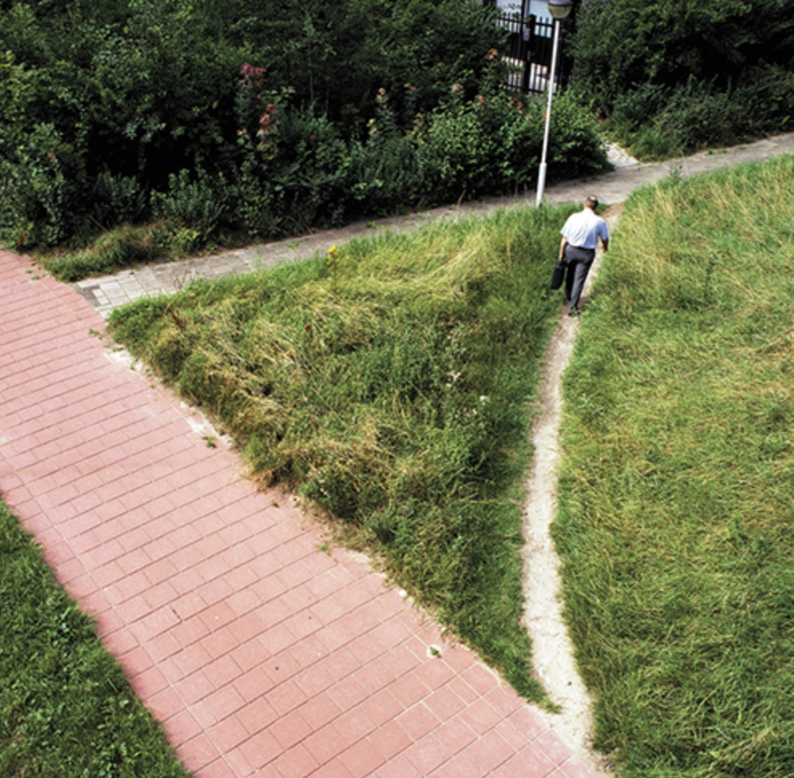
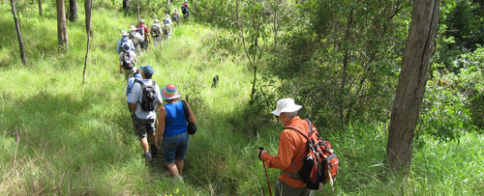

Slide 9

1. determine what the educational future is that “you” wish to “make”
2. decide which ed techs to use and what systems need to be amended to “make” that educational future
3. digitalisation

Slide 10
As an educational institution, what are the big ideas that describe the educational future you desire?
Your educational values.
Your educational vision.
Your educational mission.
Your key future educational scenarios.
Your key goals/strategies to “make” that educational future.

Slide 11
Systemic Imperatives for Effective Educational Technology Integration
The three S’s framework: Synchronisation, Systems and Synergies

Slide 12
Synchronisation = alignment
Systems = dynamic interconnectedness
Synergies = the total is more than the sum of its parts

Slide 13
Let’s illustrate these three concepts using six – mostly educational - examples

Slide 14
A. Systems Theory

Slide 15
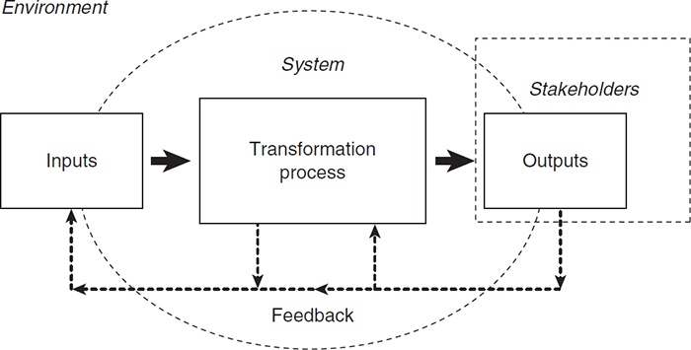
http://sk.sagepub.com/books/key-concepts-in-organization-theory/n33.xml

Slide 16
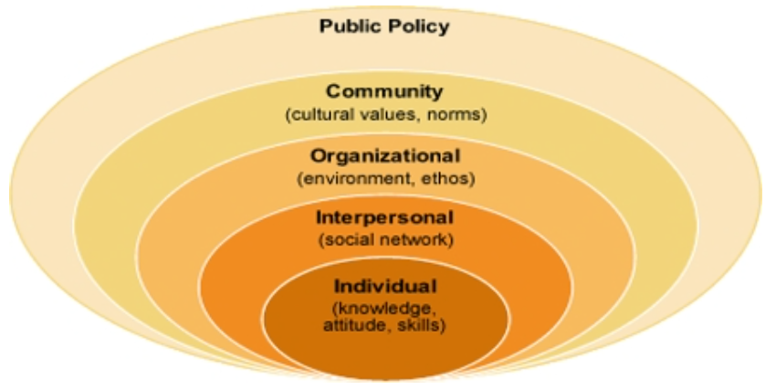
Social Ecological Model
https://assignmentpoint.com/social-ecological-model/

Slide 17
B. TPCK framework

Slide 18
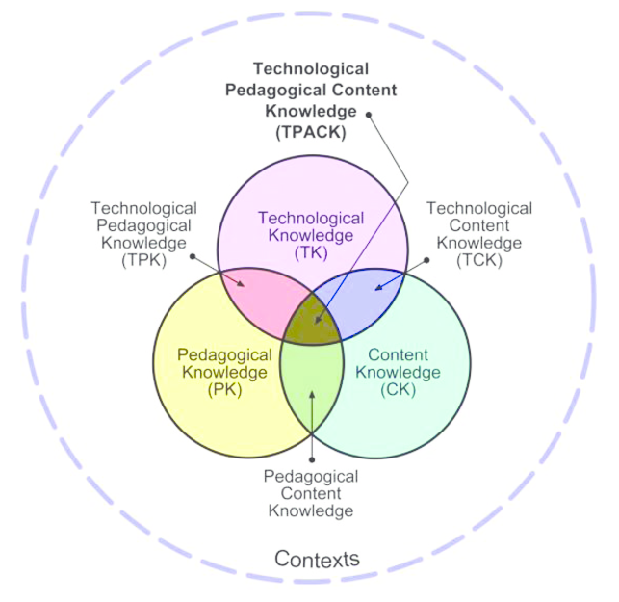
https://educationaltechnology.net/technological-pedagogical-content-knowledge-tpack-framework/
http://www.tpack.org/

Slide 19
C. Constructive alignment

Slide 20
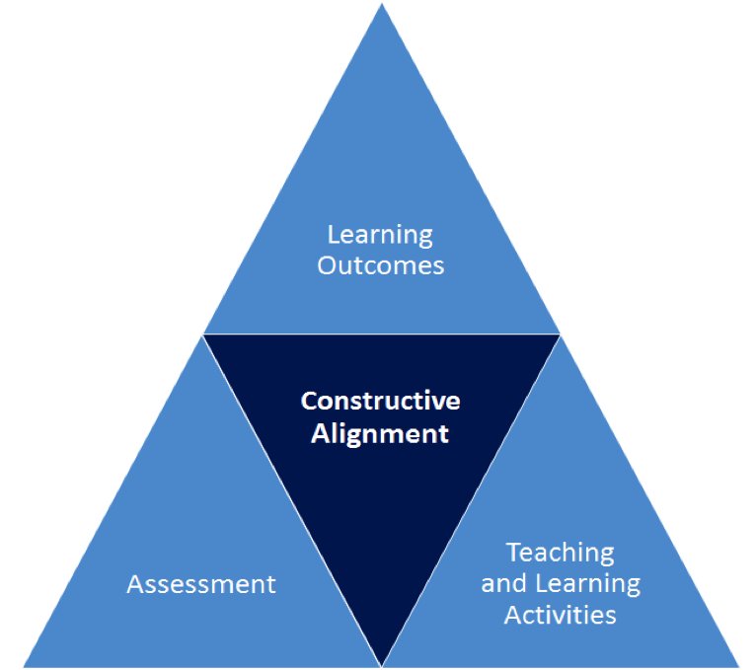
(Biggs, 2003)

Slide 21
D. “The Global School”

Slide 22
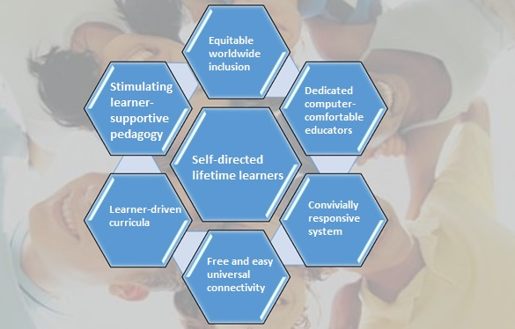
(Douse, M. & Uys P.M, 2019; 2020)

Slide 23


Free books and follow-up papers
Mike Douse and Philip Uys
globe-online.com/mikeandphilipjointpublications
THE GLOBAL SCHOOL - Education in the Time of Digitisation
PDF for free (and at Amazon.com):
globe-online.com/theglobalschool.pdf
ONE WORLD ONE SCHOOL - Education’s forthcoming fundamental transformation
PDF for free (and at Amazon.com):
globe-online.com/oneworldoneschool.pdf

Slide 24
E. Foundational elements of an educational system

Slide 25
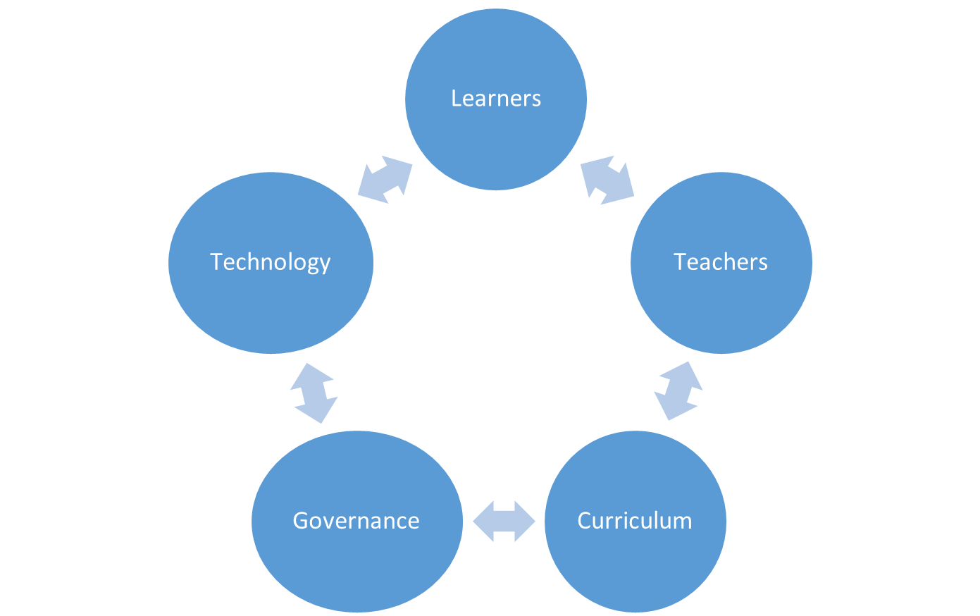
(Uys P.M, 2022)

Slide 26
F. LASO model

Slide 27
  Leadership, Academic and
  Student Ownership (LASO) model
Top down, bottom up and inside-out strategies need to be synchronised to ensure positive and effective change i.e. transformation
(Uys, P.M. 2007; 2015).

Slide 28
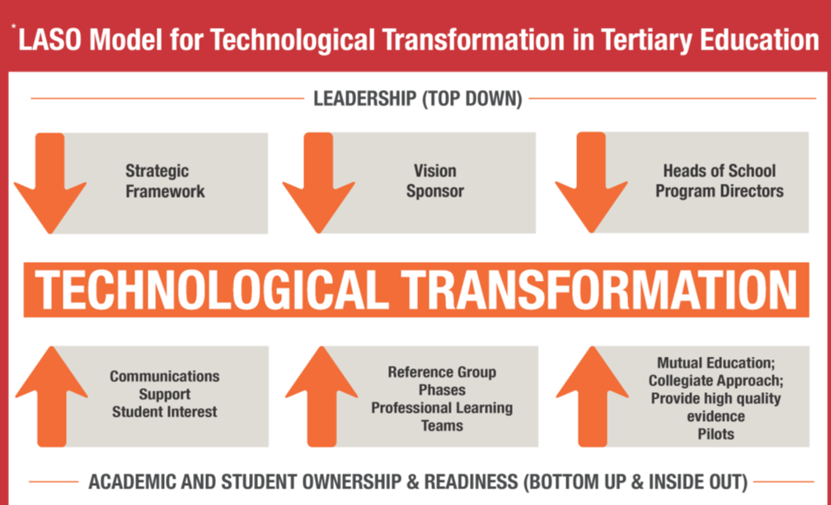

Slide 29
  All is never said
  Ibo people

Slide 30
CONCLUSION

Slide 31
Consider the following systemic imperatives for
effective educational technology integration / digitalisation:
determine what the educational future is that “you” wish to “make”; then decide which ed techs to use and what systems need to be amended to “make” that educational future; then proceed to digitalisation
the three S’s framework - Synchronisation, Systems, Synergies
the LASO Model

Slide 32
(Horton, M. & Freire, P., 1990)

Slide 33


Slide 34
THANK YOU!
COMMENTS AND QUESTIONS?
Prof Dr Philip Uys
Senior International Education Consultant
Adjunct Associate Professor Education, University of Adelaide, Australia
http://www.globe-online.com
https://www.linkedin.com/in/philipuys
http://www.globe-online.com/mikeandphilipjointpublications

Slide 35
References
Biggs, J.B. (2003). Teaching for quality learning at university. Buckingham: Open University Press/Society for Research into Higher Education. (Second edition)
Douse, M. & Uys, P.M. (2019, March). THE GLOBAL SCHOOL - Education in the Time of Digitisation. Online: self-published. ISBN-10: 1091325065; ISBN-13: 978-1091325067; ASIN: B07Q11L6C1. Available http://www.globe-online.com/theglobalschool.pdf; Kindle and paperback https://www.amazon.com/GLOBAL-SCHOOL-Education-Time-Digitisation-ebook/dp/B07Q11L6C1/ref=tmm_kin_title_0?_encoding=UTF8&qid=1553379593&sr=1-1
Douse, M. & Uys, P.M. (2020). ONE WORLD ONE SCHOOL - Education’s forthcoming fundamental transformation. Online: self-published. ISBN: 9798626785883; ASIN: B0861B163X. Available http://www.globe-online.com/oneworldoneschool.pdf; Kindle and paperback https://www.amazon.com/dp/B0861B163X

Slide 36
Freire, P. (1970). Pedagogy of the Oppressed. New York: Herder and Herder.
Horton, M. & Freire, P. (1990). We Make the Road by Walking. Philadelphia, PA: Temple University Press.
Mishra & Koehler (2006). Technological pedagogical content knowledge: A framework for teacher knowledge. Teachers College Record, 108(6), 1017-1054.
Uys, P.M. (2007). Enterprise‐Wide Technological Transformation in Higher Education: The LASO Model. International Journal of Educational Management (ISSN: 0951‐354X), Emerald, UK.
Uys, P.M. (2015). Using the LASO model to review a learning management system implementation to enhance distance e‐learning. Proceedings of the 26th ICDE (International Council for Distance Education) World Conference. Sun City, South Africa: ICDE
Veletsianos, G. & Moe, R. (2017). The Rise of Educational Technology as a Sociocultural and Ideological Phenomenon. EDUCAUSE Review. Retrieved from https://er.educause.edu/articles/2017/4/the-rise-of-educational-technology-as-a-sociocultural-and-ideological-phenomenon?lipi=urn%3Ali%3Apage%3Ad_flagship3_feed%3BgTGfmuchTny2kpDc2AjtlA%3D%3D

