Slide 1
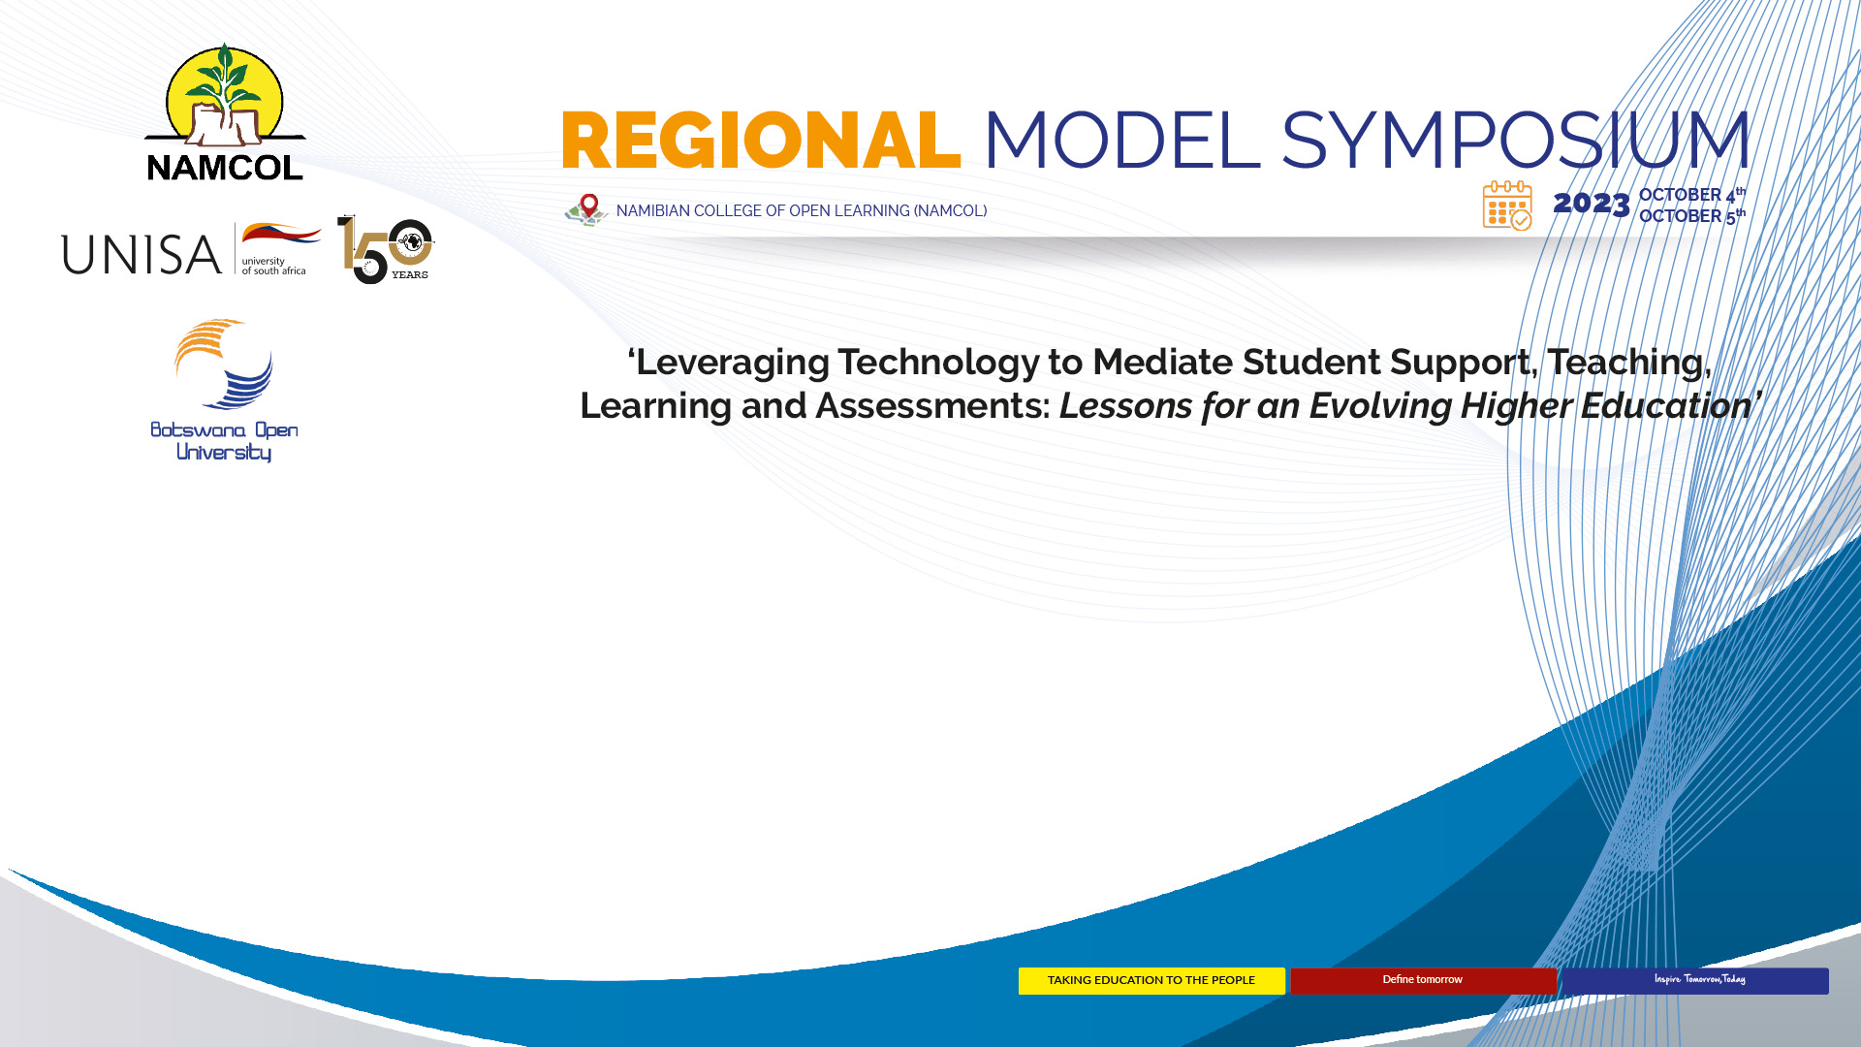
Title: Evaluation of Moodle OER for Junior Course Business Subjects students at
Botswana Open University’s Centre for Open Schooling
Dr Tommie Hamaluba– Subject Specialist, (Business)
Botswana Open University
Email: thamaluba@staff.bou.ac.bw

Slide 2
Comprehending Botswana Open University
BOU was established in December 2017.
Re-designation of the Botswana College of Open and Distance Learning (BOCODOL).
A public University – providing education by Open and Distance Learning.
BOU’s value proposition: accessibility, affordability, flexibility, equity, quality, inclusivity and digital flagship amongst others.
Source: www.bou.ac.bw

Slide 3
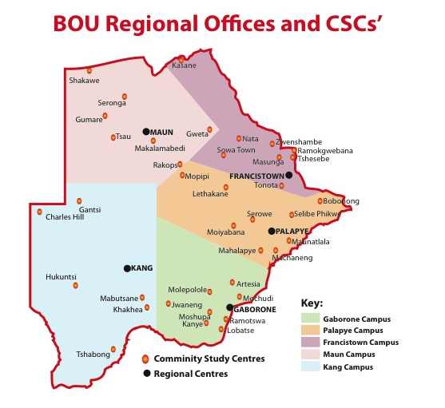

Slide 4
Introduction
College of Open Schooling
Subject Specialists
Focus on Open and Distance Education
Moodle Portal for Business Subjects
  http://openschooling.bou.ac.bw/moodle/

Slide 5
Background
Significance of Open Educational Resources (OER) in enhancing accessibility and affordability of educational materials.
Integration of technology in education and the role of Learning Management Systems (LMS) like Moodle.

Slide 6
Research Objective
The primary objective of the study: To evaluate the effectiveness and impact of Moodle-based Open Educational Resources for Junior Course Business Subjects Students at BOUCOS.
Importance: Relevance of the study in improving the quality of education for junior-level business subjects' students,
The potential benefits of using Moodle OER; enhancing engagement, self-directed learning, and overall learning outcomes.

Slide 7
Methodology
The study employed a mixed-methods approach.
Surveys, interviews, and data analysis, to gather comprehensive insights.
50 BOU students and 30 from conventional school; 10 tutors.

Slide 8
Outcomes
Potential improvements in student performance, engagement levels, and perceptions of Moodle OER.
The potential for informing future curriculum development and online learning strategies.

Slide 9
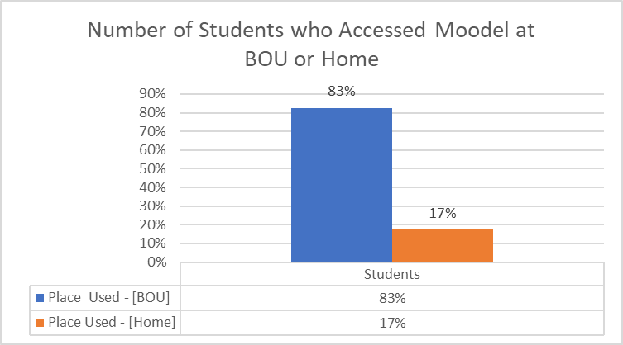
RESULTS: Figure 1

Slide 10
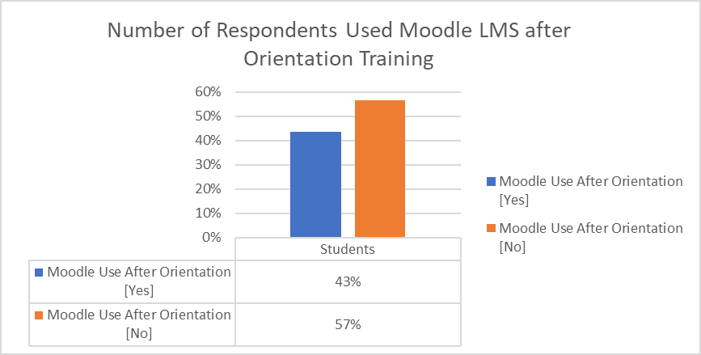
Figure 2

Slide 11
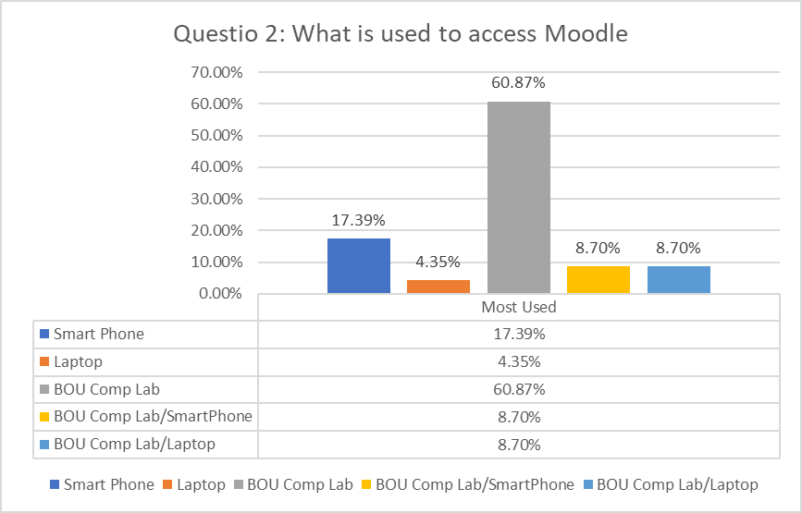
Figure 3

Slide 12
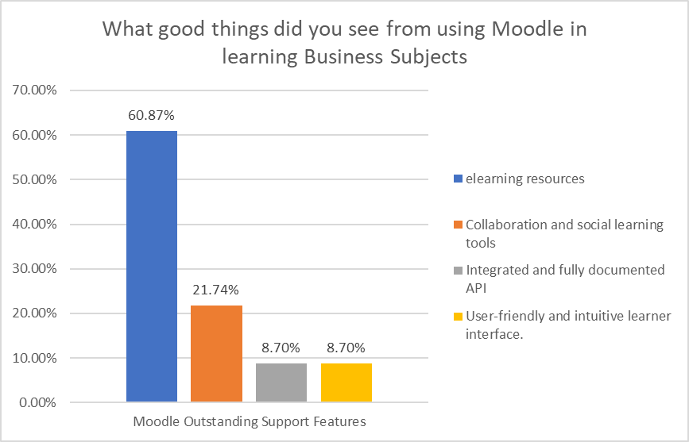
Figure 4

Slide 13
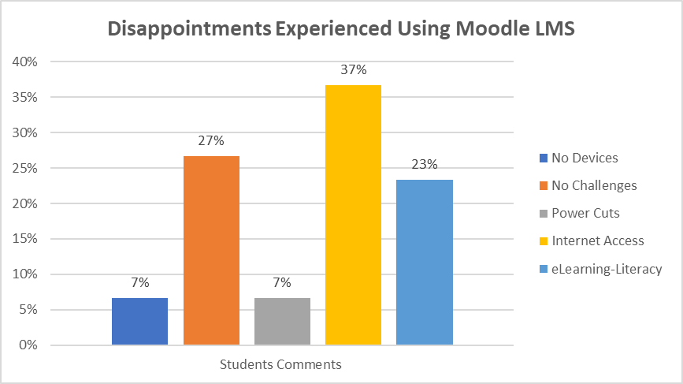
Figure 5

Slide 14
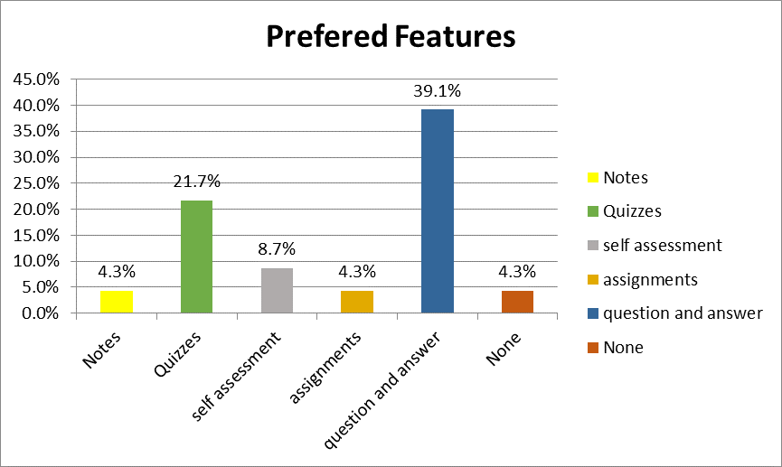
Figure 6

Slide 15
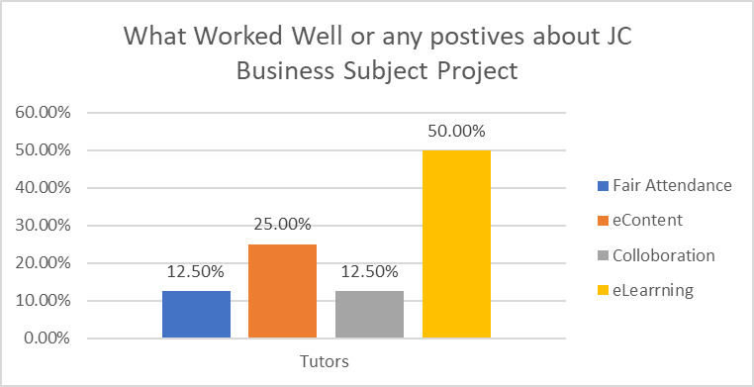
Figure 7

Slide 16
RECOMMENDATIONS
Pedagogical Alignment
User-Centric Design
Diverse Learning Pathways
Formative Assessment Integration
Continuous Monitoring and Feedback Loop

Slide 17
References
Hamaluba, T. (2022). An assessment of computer and ICT skills at Botswana Open University: Implications of ICT in business subjects. Journal of Learning for Development, 9 (1), 104-116.
Krull, G., & De Klerk, D. (2021). Online teaching and learning is not just for pandemics, and it can help solve old problems. The Conversation. https://theconversation. com/online-teaching-and-learning-is-not-just-for-pandemics-and-it-can-help-solve-old-problems-169650.
UNESCO (2020), COVID-19 Educational Disruption and Response.
https://en.unesco.org/covid19/educationresponse/.
https://teachertaskforce.org/blog/teachers-innovating-education-transformation

