Slide 1
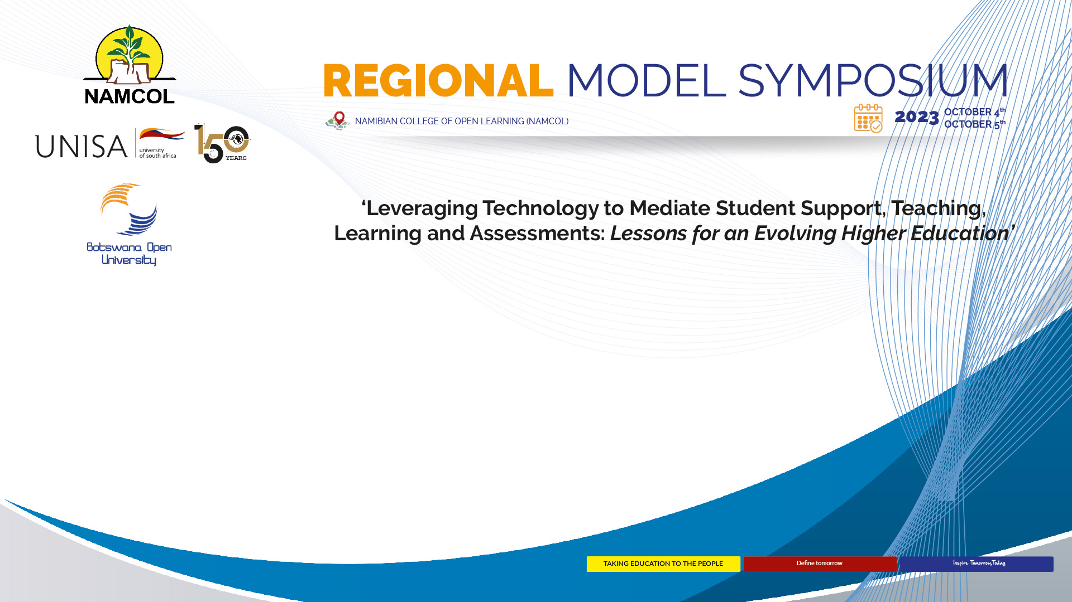
Professional Development in the Era of AI: Policies, Skills Set, Ethics and Integrity for Optimum Administration of ODeL Institutions
By
Dr Sadrag Panduleni Shihomeka
Head of Department: Higher Education and Lifelong Learning &
Senior Lecturer: Media, Educational Technologies and Research methodologies
School of Education
University of Namibia
E-mail: spshihomeka@unam.na

Slide 2
INTRODCUTION
has become an essential part of modern life, offering increased efficiency and convenience across a variety of industries.
The integration of AI has led to exciting opportunities and valid concerns about how to effectively incorporate these tools into the classroom, particularly in remote learning environments.
ability to personalize instructional materials, automate routine tasks, and create adaptive assessments.
making virtual and often large courses more interactive and individualized
use data analysis to understand an individual student's learning style, strengths, and weaknesses in a subject.
used to provide personalized feedback and instruction that is tailored to the student's needs, such as asking more questions about a topic where the student is struggling.
used to grade assignments, write more relevant objectives, and even create courses.

Slide 3
is defined as the development of computer systems that can copy intelligent human behavior.
technologies that can create original content, including text and images.
AI plagiarism is the process of using generative AI to produce content that students submit as their own work for assessment tasks.

Slide 4
Why Professional Development in the digital era?
Evolving field
gaining new skills through continuing education and career training after entering the workforce.
can include taking classes or workshops, attending professional or industry conferences, or earning a certificate to expand your knowledge in your chosen field.
has the potential to open opportunities for career advancement, such as
  promotions.
  can assist in honing existing skills and in learning new ones.
help you stand out in a pool of applicants; showing that you have completed professional development programs or additional industry certifications on your resume can go a long way in showing your expertise in your field
Hence it requires:
  Changes in Policies,
  Special Skills Set,
  Ethics and Integrity

Slide 5
Impact of AI ON management and administration of ODL Institutions
Data can be used in AI tools that support learning and teaching processes;
Similarly inform governance and management processes and procedures, potentially making them more effective and efficient.
play an important role in shaping the responsible development and deployment of AI technology
essential to incorporate guidance on AI to address various aspects such as academic integrity, research ethics, and the broader implications of AI deployment.
involves considerations of both a technical and organizational nature e.g hardware resources, software requirements, data management strategies, personnel and skills, and security and privacy concerns.

Slide 6
affect many administrative roles within ODL
  IT services,
  encompass admissions,
  student services,
  library,
  marketing, and finance.
  AI can be successfully embedded only with adequate training and a cultural shift.
  High volume administrative tasks, from admissions to procurement, can drain human and financial resources for ODL Institutions
  can be used in scenarios where large pre-existing databases are available where machine leaning techniques can be applied.
  can be used to identify students with potentially vulnerable profiles who might be at risk of dropout, allowing the ODL to use this information to take proactive measures to prevent

Slide 7
Establishing the skills for a digitally enabled Professional Development Interventions/programmes requires???
a broader digital skills strategy for society as a whole ensuring all are equipped with the
necessary skills to thrive in the digital age
public servants equipped with the digital user skills that support digital government maturity
diverse and multidisciplinary teams consisting of well-trained digital and non-digital professionals reflecting a blend of digital government socio-emotional skills and behaviours to design and deliver trustworthy and proactive services with users’ needs in mind
leaders that model digital government user skills and actively shape the environment to create a digitally enabled state

Slide 8
Cyber security threats
  Phishing-occurs when hackers send fraudulent digita communication-usually emails-seem to be from legitimate senders e.g. the recipient’s bank
    Aim to convince recipients to disclose data such as usernames, passwords, bank card pns, ID numbers-to be used to access the user’s sensitive information or assets
  Passwords attacks-repetitive attempts are made by hackers to duplicate a valid logon or password sequence
    Brute-force attacks-involve quessing at passwords until the hacker gets in
    Dictionary attacks-use a program to try different combinations of dictionary words
    Keylogging-uses malware to track all of a user’s keystrokes including login IDs and passwords
  Malware-a software algorithm that is commonly smuggled onto systems when users access infected files (e.g. emailed files or online download)
    Malware algorithms can harm software systems e.g. corrupt files or sometimes gain unsanctioned access to systems to achieve ends such as stealing data or viewing sensitive information

Slide 9
Ransomware-
  Once downloaded onto the user’s system, it locks personal files or computer system files and autonomously demands a ransom to unlock these files, often to be paid in bitcoin
  It is not unusual for ransomware to fail to unlock files even id the ransom is paid
Insider attacks-insiders with legitimate access can of course illicitly and fraudulently misuse their credentials to steal data, corrupt systems etc.
  Need to have systems to monitor legitimate access e.g. RPA, (audibots), termination and revoke of insider’s credentials

Slide 10
The cybersecurity toolbox
Major interventions required by organisations
  Hiring skilled cybersecurity staff
  Cutting edge cybersecurity software
  Staf training
  Revoking access
  Digital identify
  Cybersecurity frameworks
  Collaboration
  Promising future avenue-AI monitoring
  Dealing with work from home
  Promising future avenue: Quantum resistant encryption

Slide 11
DDOs-Distributed Denial of Service- make high volume velocity service requests on a web service
Request volumes can cause the webservice to crash from memory overload or exhaust bandwidth which can seriously slow services or deny services to legitimate users
Social Engineering-involves scammers personally contacting users and convincing them that they are someone else, therefore eliciting their trust and getting them to low access or in some other way compromise information

Slide 12
Ethical Issues in the Professional Development of ODL institutions
Misuse of ICT tools,
Escalating Misinformation, disinformation, and misinformation
Human rights-violations, emerging rights
Phishing, scams
Accountability
Environmental sustainability-green technologies

Slide 13
Conclusions
Lifelong Learning is the way to go in this era
There is a need for ODL Institutions and leaders to be familiar with the efficacy of AI detection software that has been developed to try and identify where AI plagiarism occurs.
Now that generative AI technologies are widely available to learners and AI plagiarism is growing as a consequence, clearly an ethical approach to plagiarism must be reconsidered

Slide 14
Recommendations for effective professional development in the digital era
Requires a close collaboration with public and private stakeholders, a facilitation of multiple perspectives in coordinated strategic discussions, building and involving a digitally skilled workforce in developing new services, and challenging the political agenda

Slide 15
Thank you!!!!

