Slide 1
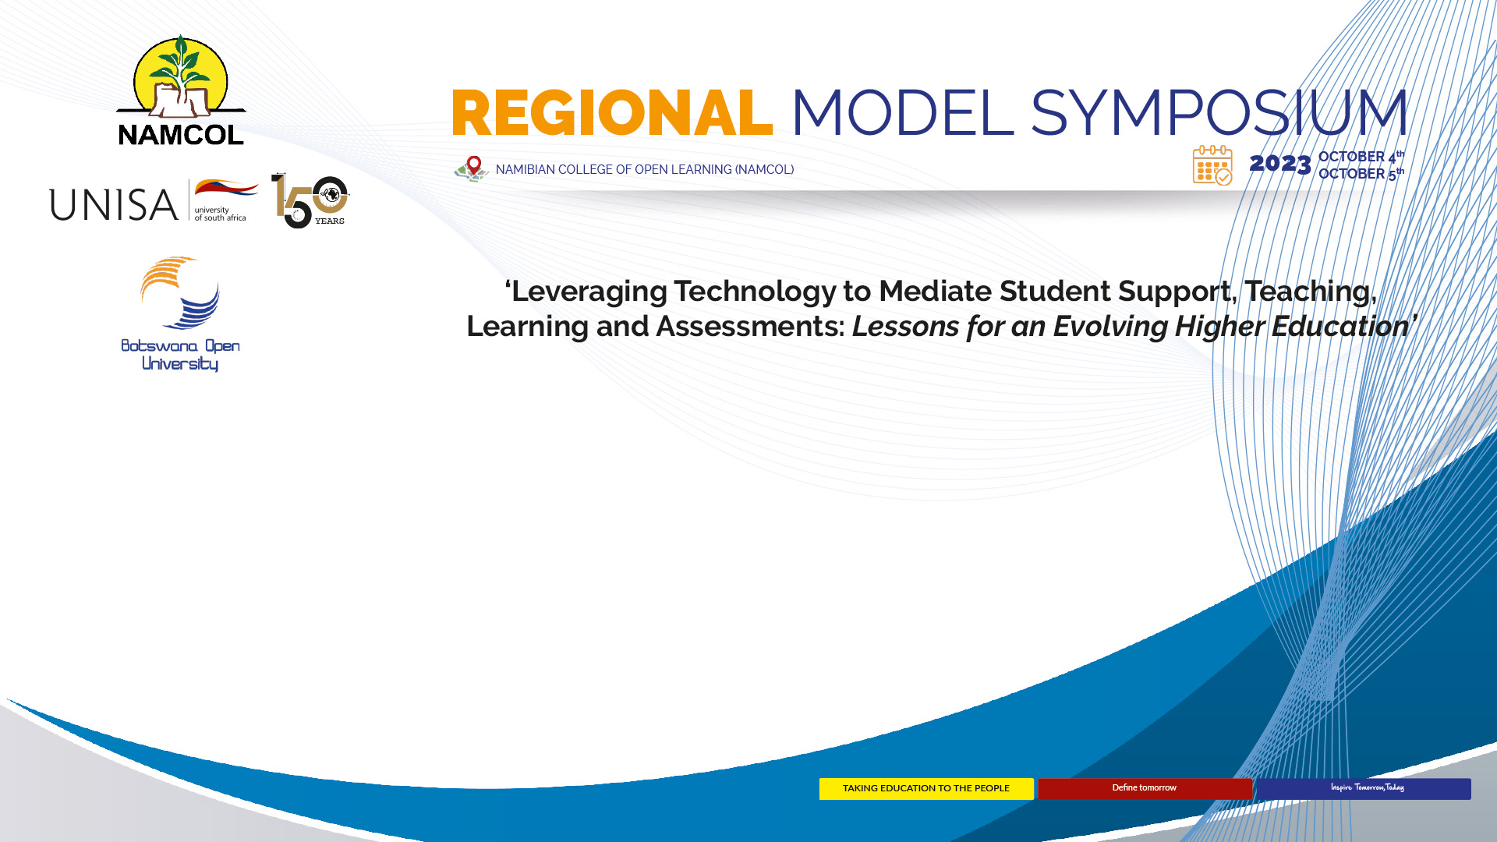
USE OF ANALYTICS FOR STUDENT SUCCESS
A CASE OF UNISA
Mr LM Marumolwa
UNISA
PORTFOLIO: STRATEGY, RISK AND ADVISORY SERVICES
DEPARTMENT: INSTITUTIONAL INTELLIGENCE

Slide 2










INTRODUCTION
1
OVERVIEW COMPLEXITIES OF PRACTISE
2
UNISA IMPLEMENTATION
3
OUTPUT
4
ACKNOWLEDGEMENTS
5

Slide 3

INTRODUCTION

Slide 4






CONTEXT
Use of Analytics for Student Success
A paradox of an ideal target and vision confused by complexities of practice
MODALITIES
Modalities of Analytics for Student Success
IMPLEMENTATION
Implementation of Analytics for Student Success
The purpose of this presentation is to share ideas at high-level on how to create an enablement of analytics for student success.
APPLICATION
Application of Analytics for Student Success
access
Access of Analytics for Student Success
Assumptions:
Existing Knowledge about UNISA
Existing Knowledge about Student Success
Existing Knowledge about Analytics
technologies
Technologies of Analytics for Student Success

Slide 5

OVERVIEW COMPLEXITIES OF PRACTISE

Slide 6
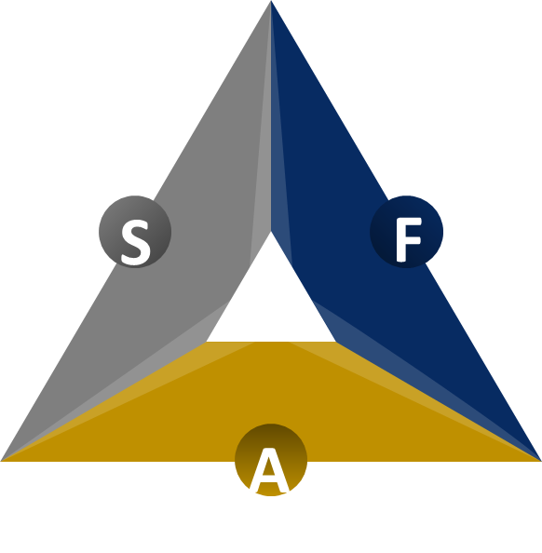
MODALITIES OF ANALYTICS FOR STUDENT SUCCESS
Scope
Focus
Application
Scope defines the boundaries and extent of a particular topic, project, or area of interest. It outlines what is included and what is excluded in a given context.
Focus refers to the main point of emphasis or the central theme of a subject, task, or discussion. It directs attention toward a particular aspect or objective.
Application involves the practical use or implementation of knowledge, techniques, or tools to achieve specific goals or solve real-world problems.
 | Learning Analytics | Learner Analytics | Academic Performance Analytics | Student Cohort Analytics
Scope | Learning analytics is a broad concept that involves analysing data related to various aspects of the learning environment, including learner behaviour, interactions with educational materials, and academic performance. | Learner analytics narrows its focus to the individual learner, involving the collection and analysis of data specific to a single student's behaviours, interactions, and academic progress. | Academic performance analytics specifically focuses on data related to students' academic achievements, including grades, test scores, course completion rates, and other performance metrics. | Student cohort analytics involves grouping students into cohorts based on shared characteristics and analysing their collective data over time.
Focus | Learning analytics primarily focuses on understanding and improving teaching and learning processes at the institutional or course level. It aims to answer questions about the effectiveness of instructional methods, curriculum design, and overall learning experiences. | Learner analytics is primarily concerned with understanding how an individual student engages with educational resources and materials. It aims to provide insights into a student's learning journey, strengths, weaknesses, and areas where they may need support. | The primary focus of academic performance analytics is to assess and improve academic outcomes, including student success, retention, and graduation rates. It aims to understand factors influencing academic performance. | The primary focus of student cohort analytics is to gain insights into trends, patterns, and changes within specific student groups. It helps institutions understand the unique challenges and needs of different cohorts.
Application | Learning analytics can inform curriculum design, help educators identify trends in student performance, and support institutional decision-making. It is used to optimize educational practices. | Learner analytics is often used to provide personalized support and interventions to individual students. Its goal is to enhance the success and satisfaction of individual learners. | Academic performance analytics helps institutions identify at-risk students, evaluate the impact of academic support programs, and make data-driven decisions to enhance overall academic effectiveness. | Student cohort analytics informs decisions related to program evaluation, resource allocation, and the development of targeted interventions to support specific groups of students, such as first-year students or students with similar demographics.

Slide 7
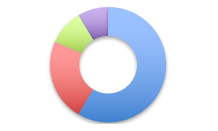
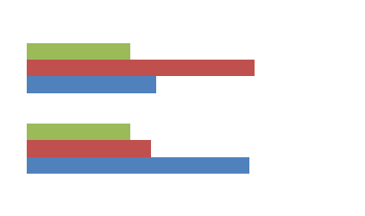
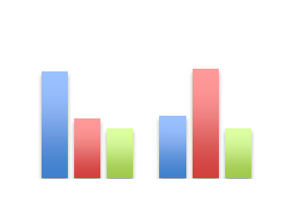
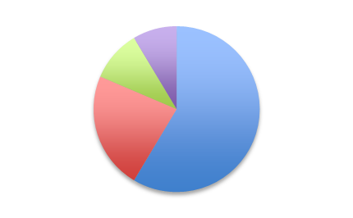
IMPLEMENTATION OF ANALYTICS FOR STUDENT SUCCESS
The use of data analytics in promoting student success is contingent upon a multitude of drivers and elements that enable the efficient gathering, examination, and utilisation of data to augment students' educational experiences and achievements.
Group 1
Group 2
Group 3
Data Availability
Institutional Culture
Personalized Interventions
Technology Infrastructure
Leadership Support
Continuous Improvement
Data Integration
Privacy and Compliance
Stakeholder Collaboration
Analytics Expertise
Data Literacy
Resource Allocation
ANALYTICS MATURITY MODEL
Descriptive
Diagnostic
Predictive
Prescriptive
What happened?
How and Why it happened?
If things continue this way what will happen?
How can we make it happen or not happen?

Slide 8
APPLICATION OF ANALYTICS FOR STUDENT SUCCESS
Qualification
Module
Assessment
Learning Activities
Progression
Cohort
Late Intervention
Intervention Scope
Cohort Throughput
Minimum Time Completion
Qualification Success
Intervention Scope
Operational | Module Design (Pedagogies) | Inform Student Success | Inform Strategy
Risk Levels
Cohort Analytics
Academic Performance
Learning Analytics
Learner Analytics
Intervention Scope
Module Success
Assessments Results
Exam Attendance
Assignment Submissions
Mid Intervention
Intervention Scope
Learning Units Grade Results
Learning Activities
LMS Access
Early Intervention

Slide 9
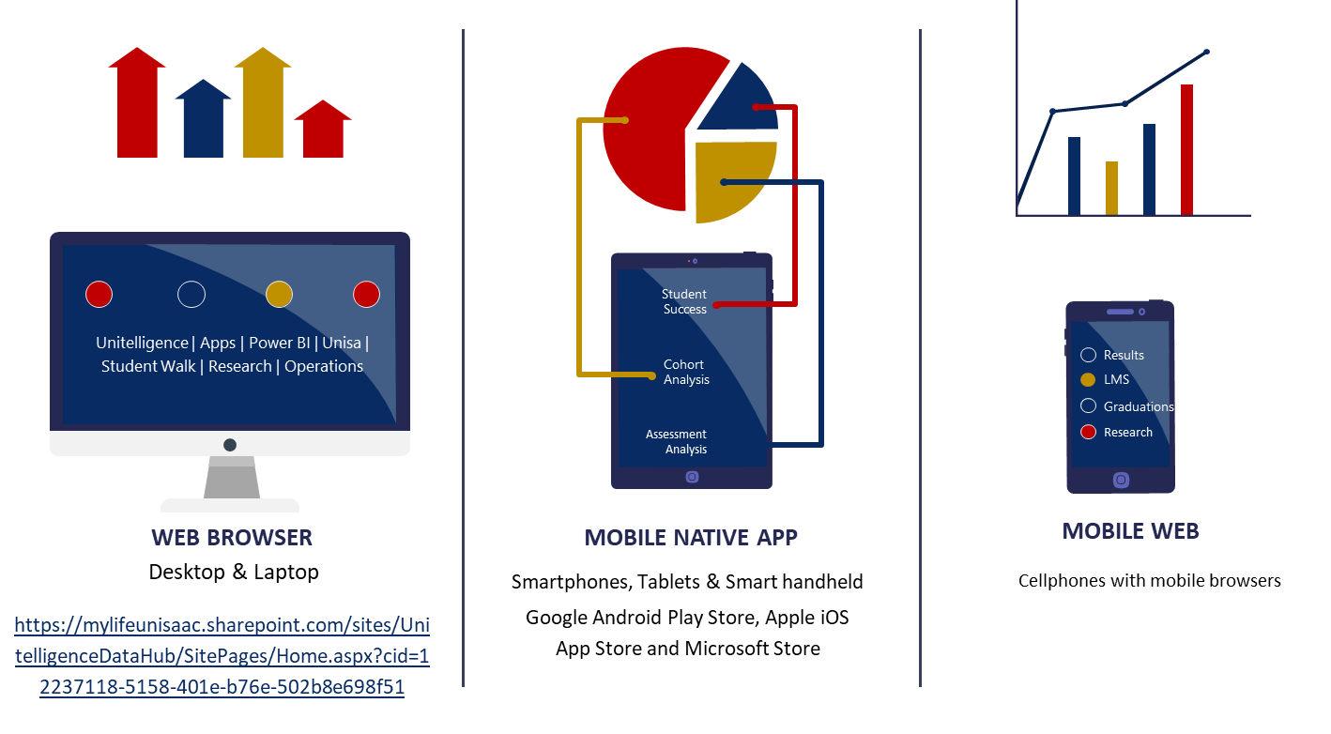
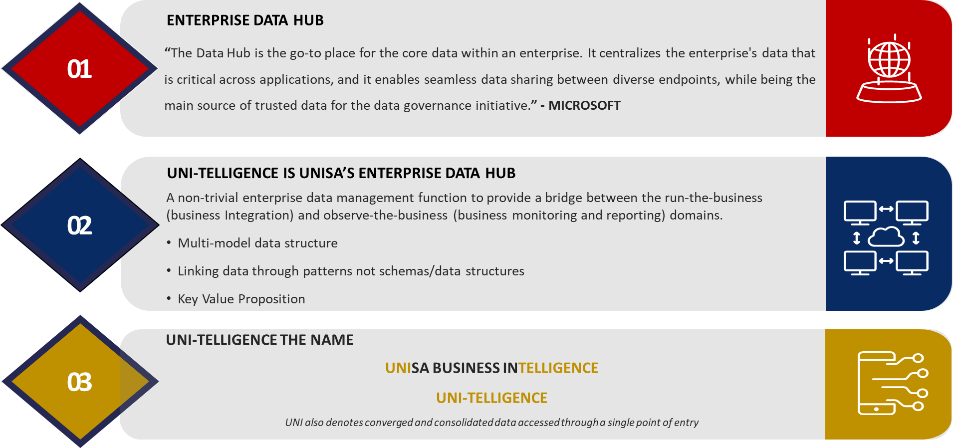
ACCESS OF ANALYTICS FOR STUDENT SUCCESS
OPTIONS OF ACCESS OF ANALYTICS FOR STUDENT SUCCESS
Intranet
Office 365 Platform
Data Hub
Power BI Service
Analytical Data

Slide 10






TECHNOLOGIES OF ANALYTICS FOR STUDENT SUCCESS
APPLICATION
DATA VISUALIZATION & PRESENTATION
DATA ANALYSIS
DATABASE
MACHINE LEARNING & AI
DATA INTEGRATION

Slide 11

UNISA IMPLEMENTATION

Slide 12
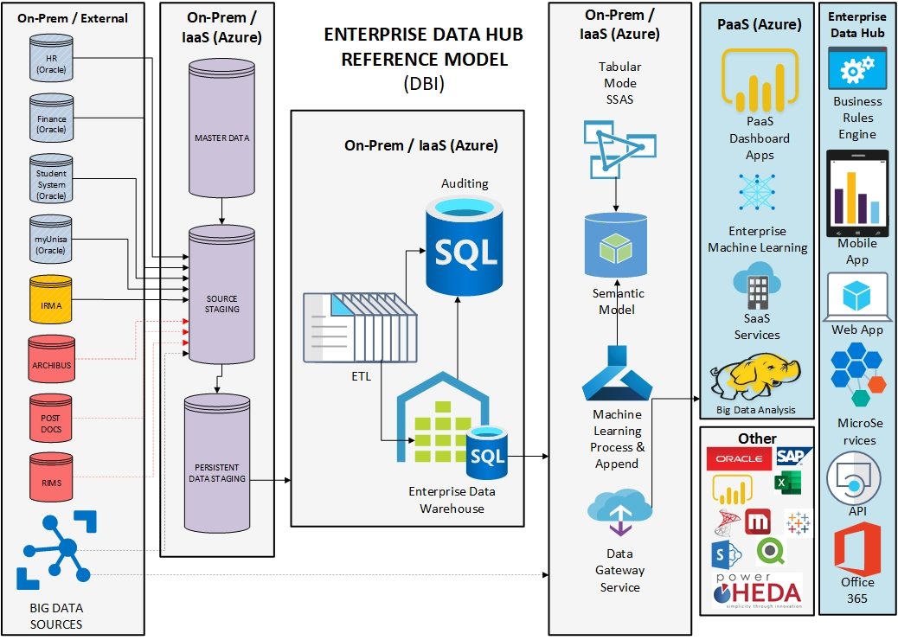
UNI-TELLIGENCE ACHITECTURE REFERENCE
Data Growth (IoT | M2M | Cloud | Edge Computing) | Big Data | Dark Data

Slide 13
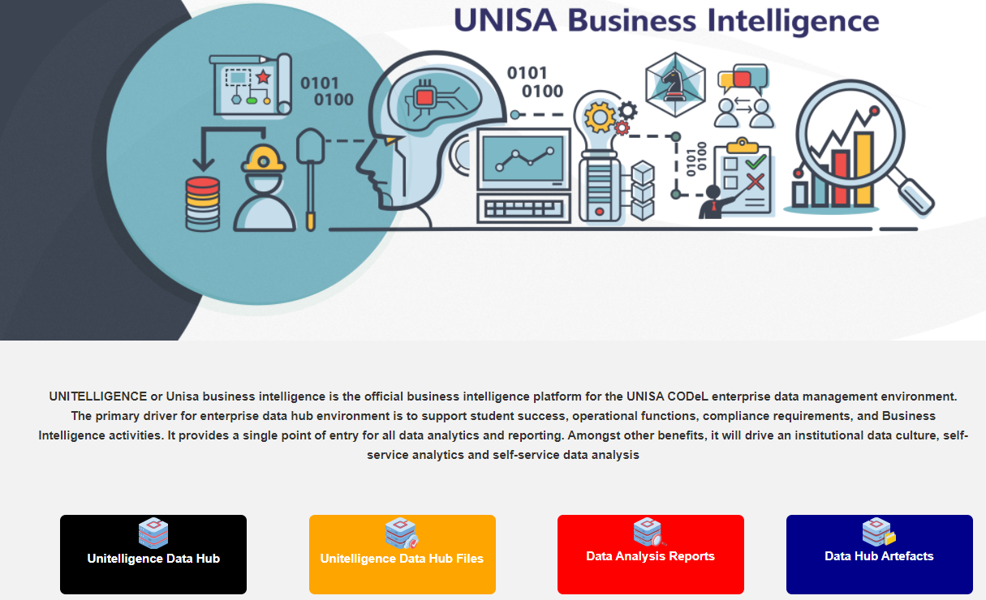
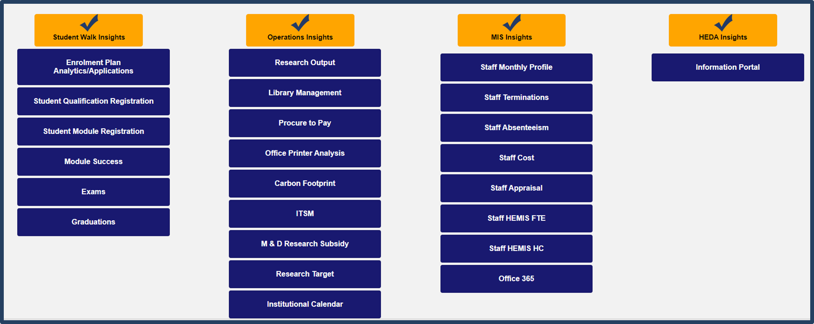
UNI-TELLIGENCE DATA HUB

Slide 14






INFORMATION PROUDUCT APPROACH
Strategic Objective
Decisions / Actions
People
Source
Systems
Data Sources
1
2
4
5
6
Business Questions
3
A strategic objective is a clear and concise statement that outlines an organization's long-term goal or desired outcome. It provides a high-level direction for the organization and helps guide its actions and decisions.
The process by which leaders and teams choose a course of action from various options to achieve specific objectives. Effective decision-making relies on data, analysis, and sound judgment.
Business questions are inquiries that individuals or organizations pose to gain insights, make informed decisions, and drive their operations forward.
People in the context of business intelligence and analytics are the driving force behind data-driven decision-making and strategy development within organizations, with their ability to interpret and apply data insights being a key factor in business success.
Source systems are critical components of an organization's data infrastructure, serving as the starting point for data processing, analysis, and decision-making.
Data sources represent the diverse and valuable origins of data that organizations leverage to gain insights, make informed decisions, and drive their operations forward.

Slide 15
CHANGE MANAGEMENT PLAN
ADKAR has be adopted as the Change Management framework to support the impacted and affected stakeholders by creating awareness, developing the required knowledge and ability to implement and support BI & Analytics
Desire
Knowledge
Ability
Reinforcement
Awareness
Awareness
Create awareness around BI & Analytics project through targeted and specific communications and engagement to all impacted stakeholder, executives and forums whose support is crucial for the successful delivery of the project
Desire
Build interest around BI & Analytics through continuous and focused benefits orientated engagements (WITFM) with stakeholders such as leadership.
Knowledge
Unisa on BI & Analytics navigation and functionality to acquire knowledge, skills and behaviours required to effectively deploy BI & Analytics capabilities into the environment
Ability
Incorporate BI & Analytics demo and show and tell sessions as part of the training to enable users to experience the system live and demonstrate their ability to execute the expected tasks with comfort prior to go-live.
Reinforcement
Reiterate the benefits of the project through communications, events and engagements which showcase and create excitement around the project milestones
Post go-live
Develop toolkit to support users to sustain the change

Slide 16
COLLABORATION PLAN
User Competency
DII Enablement
Outcome
Knowledgeable User
User that has experience and advanced knowledge of deriving insights from Information Products. They are very comfortable with the tools or software and other less familiar users often asks them for assistance.
We provide training and support for ad hoc request. We develop user artefacts on advise of these users, that will assist them understand the data structures better.
Advanced User | User Train Other Users | Improve Information Products | Communicate New Updates | Get User Feedback
Advanced Users
Data Analysts who are proficient with analytical tools and process and are working with data stewards to develop key granular information products for their departments.
We endorse their information products and provide artefacts that breaks down the semantic model and provide data dictionaries of the data structures that supports semantic model. We work with them to improve and expand our semantic model. We incorporate source data that is critical for their information products. We ensure that their BI applications are authorized to access the required data.
Grow the semantic model | Increase Support for Information Products | Continuous Feedback on the Semantic Layer
Super Users
Developers who understands the Software Development Lifecycle (SDLC) and highly proficient with applicable systems and software development tools.
We provide comprehensive training on our BI framework and Strategy. We provide them access to deploy and commit code and changes through a governed process. We assist with code reviews and optimizations. Promote workspace to enterprise premium capacity.
Implement BI Strategy | Grow the Data Warehouse | Improve Data Engineering

Slide 17

OUTPUT

Slide 18
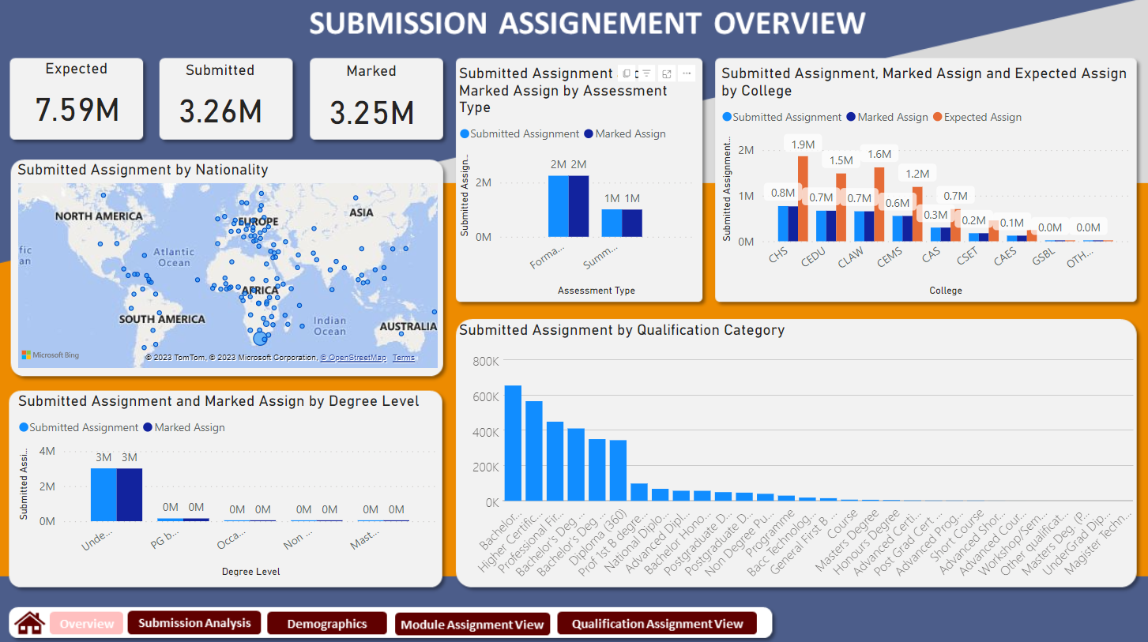
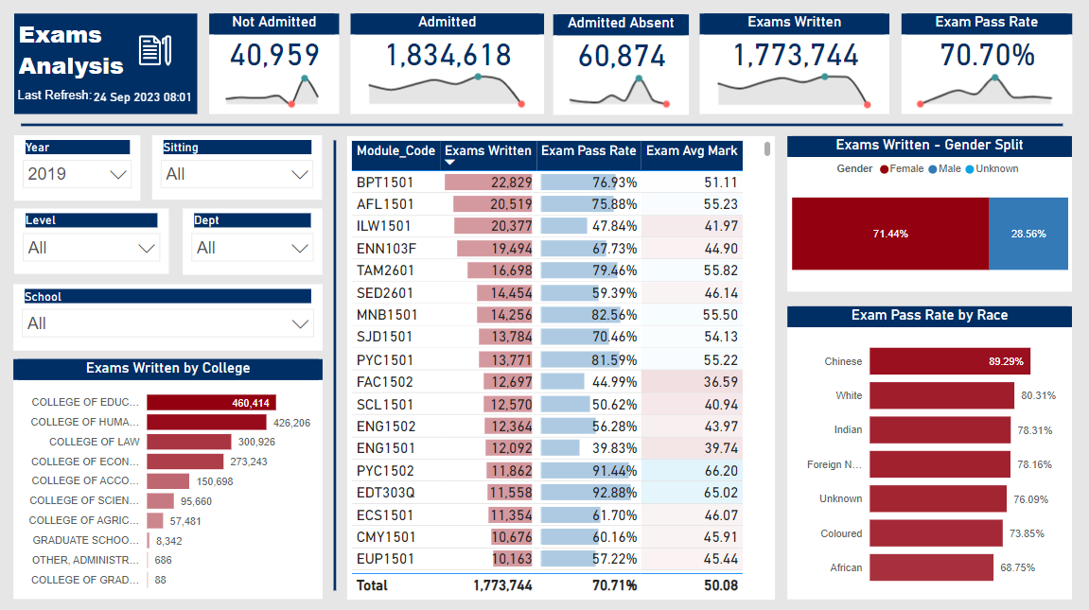
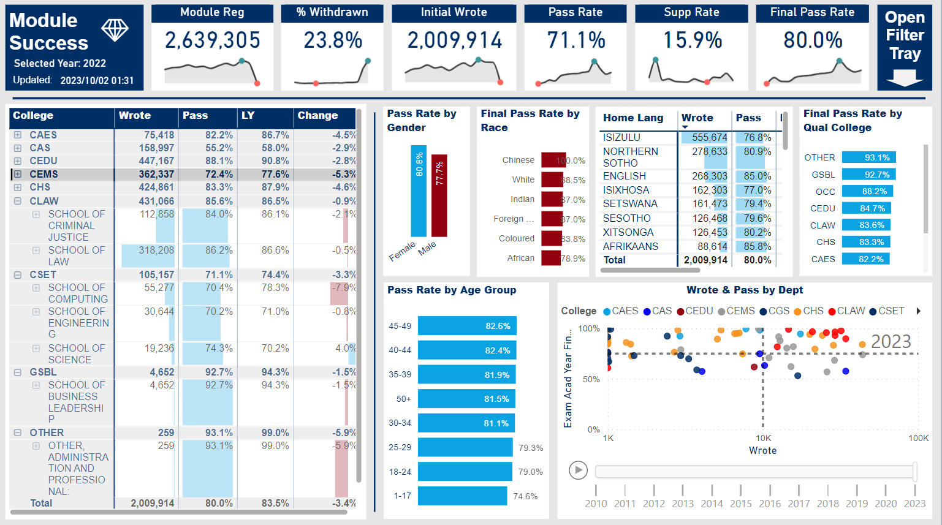
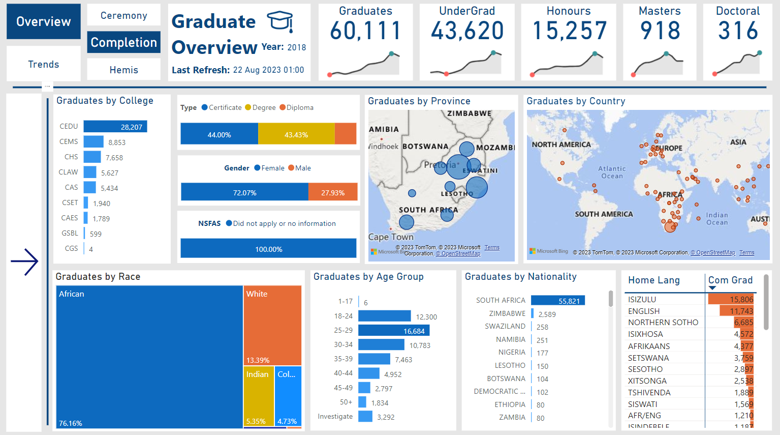
SAMPLE INFORMATION PRODUCTS

Slide 19

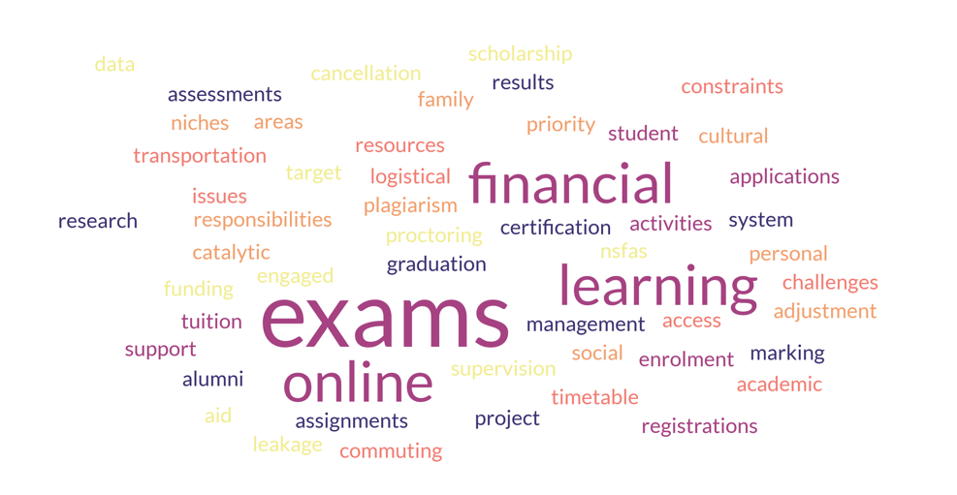






ENABLEMENT VEHICLE FOR STUDENT SUCCESS ANALYTICS
STUDENTS’ACADEMIC PERSISTANCE NEEDS
Executives
Management
Academics
Operations
Administration
Academic Project
Unisa Strategy
Institutional Planning
Digital Transformation
Student Walk
Research Output
Engaged Scholarship
Regulations
Uni-telligence UI
Power BI
Report
Analytical Database
Enterprise Data Warehouse
Source Data
DIGITAL INFRASTRUCTURE | DATA GOVERNANCE | DATA MANAGEMENT | CLOUD INVESTMENT | DIGITAL SECURITY | 4IR SKIILS
Integrated Data Service
Exploiting Existing Reporting & Analytics Investments
Embracing Diversity in Reporting Technologies
Single Point of Entry for all Analytics & Reporting
Multi-function analytics on a unified platform that eliminate silos and speed the discovery of data-driven insights
True hybrid capability with support for public cloud, multi-cloud, and on-premises deployments
A shared data experience that applies consistent security, governance, and metadata
Better use of the available data and leverage the right data to create competitive advantages
UNI-TELLIGENCE is a vehicle for digital transformation through data, it is more than analytics and reporting, it is the implementation of the UNISA’s enterprise data management blueprint.

Slide 20
KEY ENABLEMENT ARCHIEVEMENTS
Over 70 Workspaces
Multiple Contributors’ Content
Academics Producing Content
Onboarding All Organizational Processes
Data Insights Culture
Single Point of Entry
Over 350 Reports

Slide 21

ACKNOWLEDGEMENTS

Slide 22
ACKNOWLEDGEMENTS
VP: Strategy, Risk and Advisory Services
Prof SK Ndlovu
1
(Executive Support & Leadership)
Executive Director: Institutional Intelligence
Dr MP Molapo
2
(Senior Management Support & Leadership)
3
Directorate Business Intelligence
(Capacity and development Support)
4
ICT
(Operational Support)
5
Collaborators
(Contribution Support)

Slide 23
REFERENCES
Guzmán-Valenzuela, C. et al. (2021) ‘Learning analytics in higher education: a preponderance of analytics but very little learning?’, International Journal of Educational Technology in Higher Education. doi: 10.1186/s41239-021-00258-x.
Han, J. et al. (2021) ‘Learning analytics dashboards for adaptive support in face-to-face collaborative argumentation’, Computers and Education, 163. doi: 10.1016/j.compedu.2020.104041.
Hasnain, A. et al. (2017) ‘BioFed: Federated query processing over life sciences linked open data’, Journal of Biomedical Semantics, 8(1), pp. 1–20. doi: 10.1186/s13326-017-0118-0.
Hernández-de-Menéndez, M. et al. (2022) ‘Learning analytics: state of the art’, International Journal on Interactive Design and Manufacturing, 16(3). doi: 10.1007/s12008-022-00930-0.
Kahu, E. R. and Nelson, K. (2018) ‘Student engagement in the educational interface: understanding the mechanisms of student success’, Higher Education Research and Development, 37(1). doi: 10.1080/07294360.2017.1344197.
Khalil, M., Prinsloo, P. and Slade, S. (2022) ‘The use and application of learning theory in learning analytics: a scoping review’, Journal of Computing in Higher Education. doi: 10.1007/s12528-022-09340-3.
Kleimola, R. and Leppisaari, I. (2022) ‘Learning analytics to develop future competences in higher education: a case study’, International Journal of Educational Technology in Higher Education, 19(1). doi: 10.1186/s41239-022-00318-w.
Marbouti, F., Ulas, J. and Wang, C. H. (2021) ‘Academic and Demographic Cluster Analysis of Engineering Student Success’, IEEE Transactions on Education, 64(3). doi: 10.1109/TE.2020.3036824.
Maseleno, A. et al. (2018) ‘Demystifying learning analytics in personalised learnin’, International Journal of Engineering and Technology(UAE), 7(3). doi: 10.14419/ijet.v7i3.9789.
McIntosh, E. and Nutt, D. (2022) ‘The Impact of the Integrated Practitioner: Perspectives on Integrated Practice to Enhance Student Success*’, Student Success, 13(2). doi: 10.5204/ssj.2430.
Viberg, O. et al. (2018) ‘The current landscape of learning analytics in higher education’, Computers in Human Behavior. doi: 10.1016/j.chb.2018.07.027.
van Wyk, M. et al. (2022) ‘The relationship between resilience and student success among a sample of South African engineering students’, Cogent Psychology, 9(1). doi: 10.1080/23311908.2022.2057660.

Slide 24
THANK YOU

