Slide 1
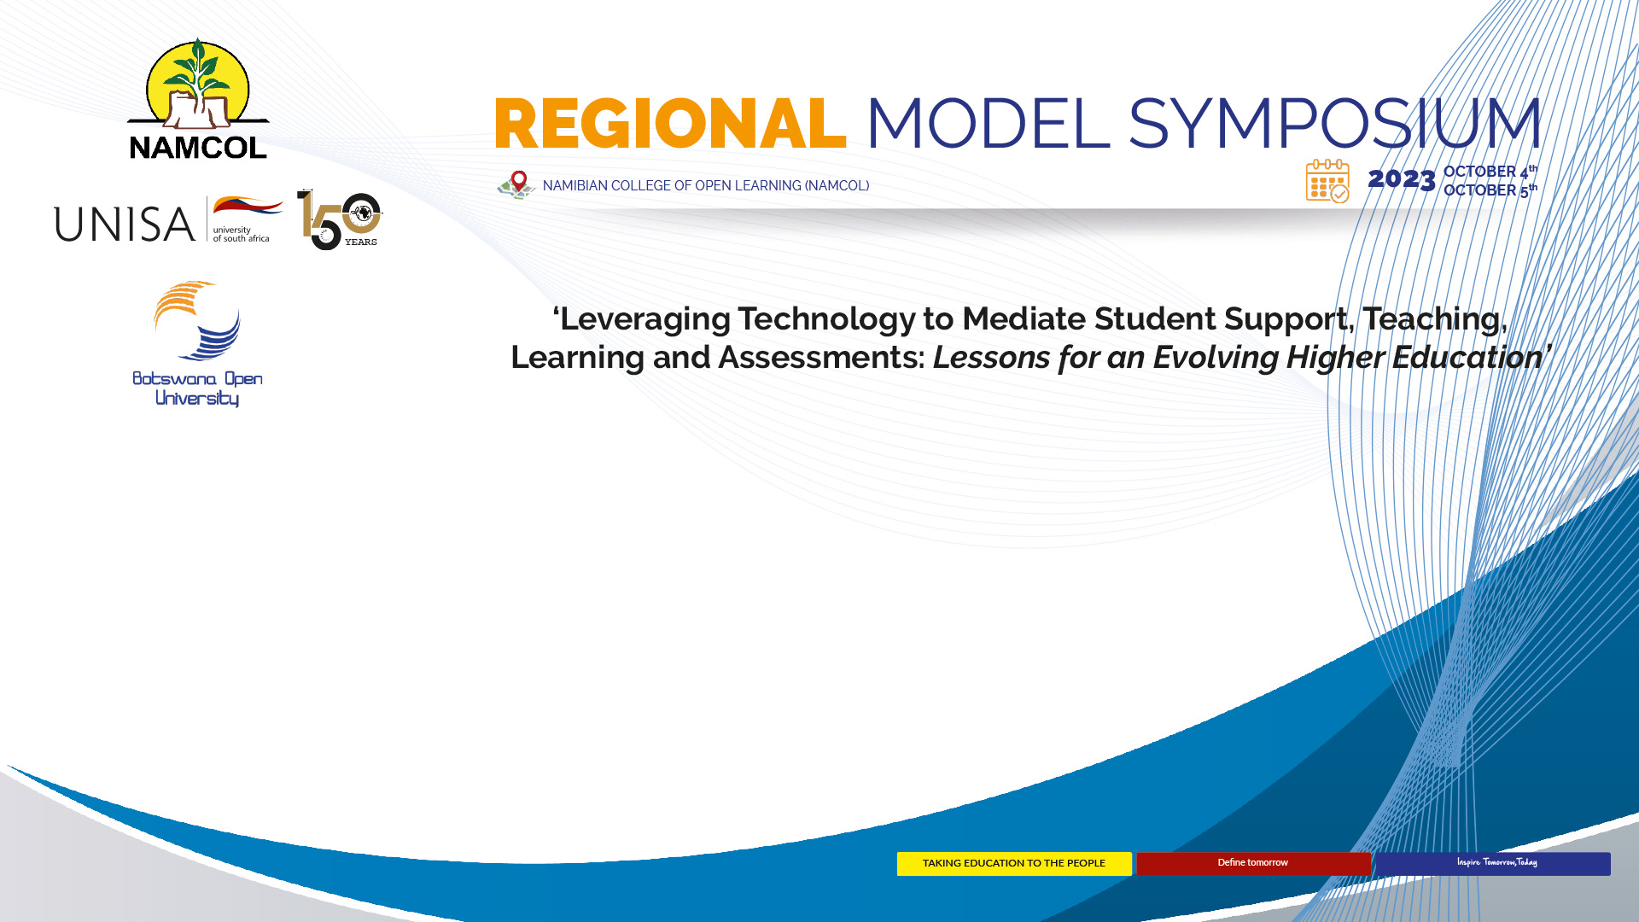
Empowering African Students for the Fourth Industrial Revolution: Leveraging Technology to Foster Digital Competencies and Enhance Preparedness for Online Learning Environments
Denzil Chetty
Academic Development Open Virtual Hub (ADOVH)
University of South Africa

Slide 2
1.0 TOWARDS A SYSTEMS THINKING FOR SOCIAL CHANGE MODEL
INPUTS
Dynamic Thinking: Understanding the problem as a set of emerging patterns.
Contextual Thinking: Understanding context drives response.
Pattern Analysis: What would happen if the system stays the same.
Programme Interventions to address the problem.
ON-GOING PROCESS
OUTPUTS
PROBLEM
OPERATIONAL THINKING
LOOP THINKING
Not a one-time effect in a rapidly progressing environment
Quantifiable/ Measurable achievements
IMPACT
Changing patterns/ behavior

Slide 3
2.0 UNPACKING THE PROBLEM: STUDENT PROFILING
STUDENT A
STUDENT B
Lack of Access to technology and connectivity.
High data costs creates an interdependency upon higher education institutions to provide data.
Gender Digital Disparities: Increasing number of female students/ socially excluded from technology exposure.
School Education: Minimum to no technology exposure.
Lack basic digital literacy competencies.
Unable to navigate a robust technology-mediated learning environment.
Negative student experience with direct impact on student throughput and student retention.
Do have access to technology: Own devices/ family members/ employer.
Can afford data costs/ interdependency on employer.
Mobile accessibility (94% of UNISA students access their learning through mobile devices)
Acquired basic digital literacy skills.
Mastered skills for mobile learning.
Acquired social networking skills through social media.
Ability to access and navigate the learning management systems.
Problem: Waiting for the University to respond to their increasing desire for technology integration
Problem: University non-responsive to their needs for access to technology and skills

Slide 4
3.0 OPERATIONAL THINKING: INPUTS
Set of training interventions that are implemented alongside the formal curriculum.
Skills that can be transferred to academic disciplines (4IR skills: critical thinking/ problem solving/ collaborative learning)
Core skills for navigating the Learning Management System (LMS) for both content/ activities/ assessments.
MOOCs = Massive Open Online Courses.
Massive: Scalable Courses with flexible design for large numbers.
Open: no restrictions. Open platform implies anyone can access the learning (UN SGD 4)
Online: Self-paced/ autonomous learning.
An African Approach: sMOOCs – Synchronous MOOCs with facilitator-led live webinars and student blast sessions
Partnering with industry.
Microsoft: Certificates/ benchmarking against industry standards and trends/ future proofing labor market skills.
Innovating: partnering with leading gaming company RGB Gaming.
Developing skills with school teachers for classroom 4IR integration – expose students to technology.
CO-CURRICULAR ACTIVITIES
DELIVERY APPROACH: MOOCS
COLLABORATIONS

Slide 5
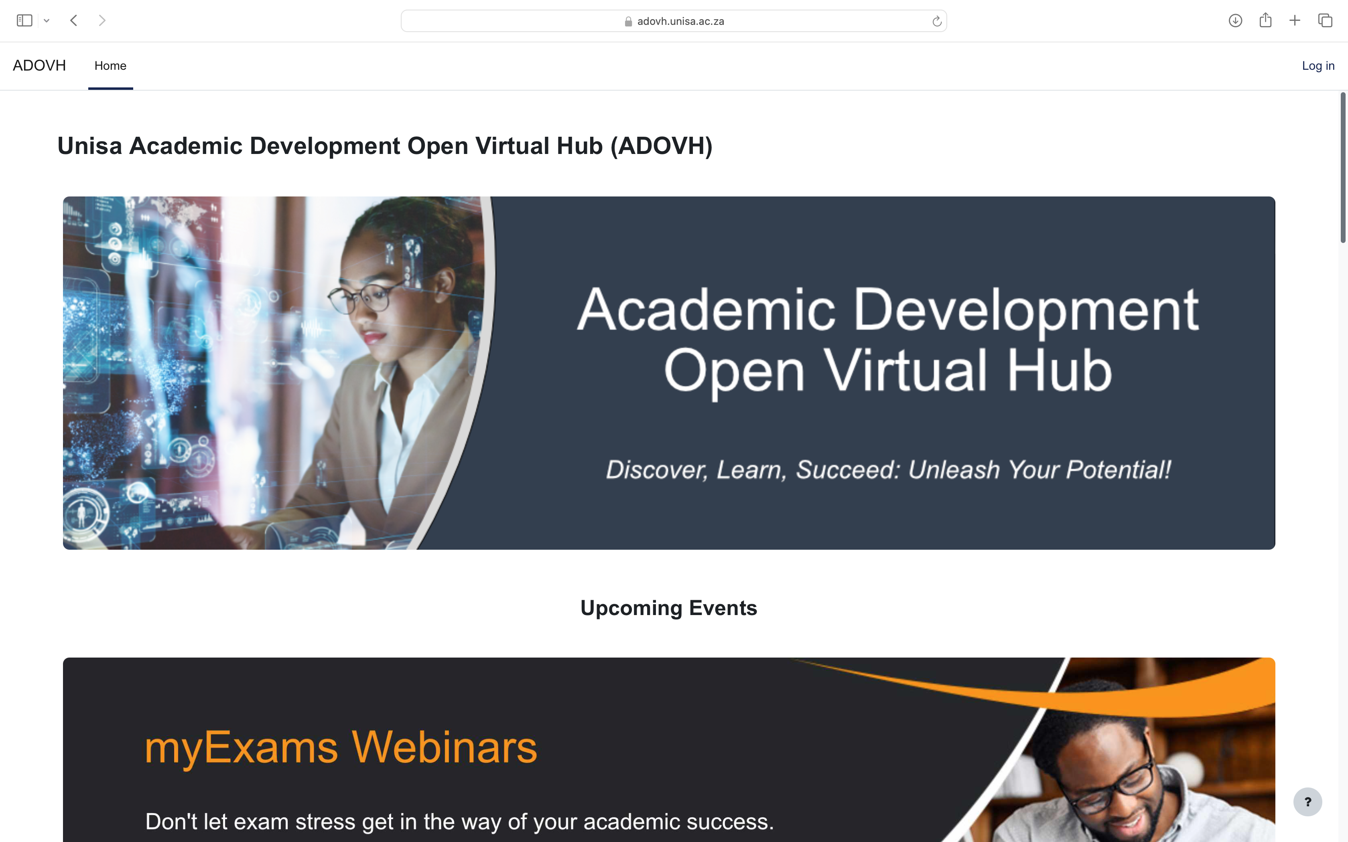
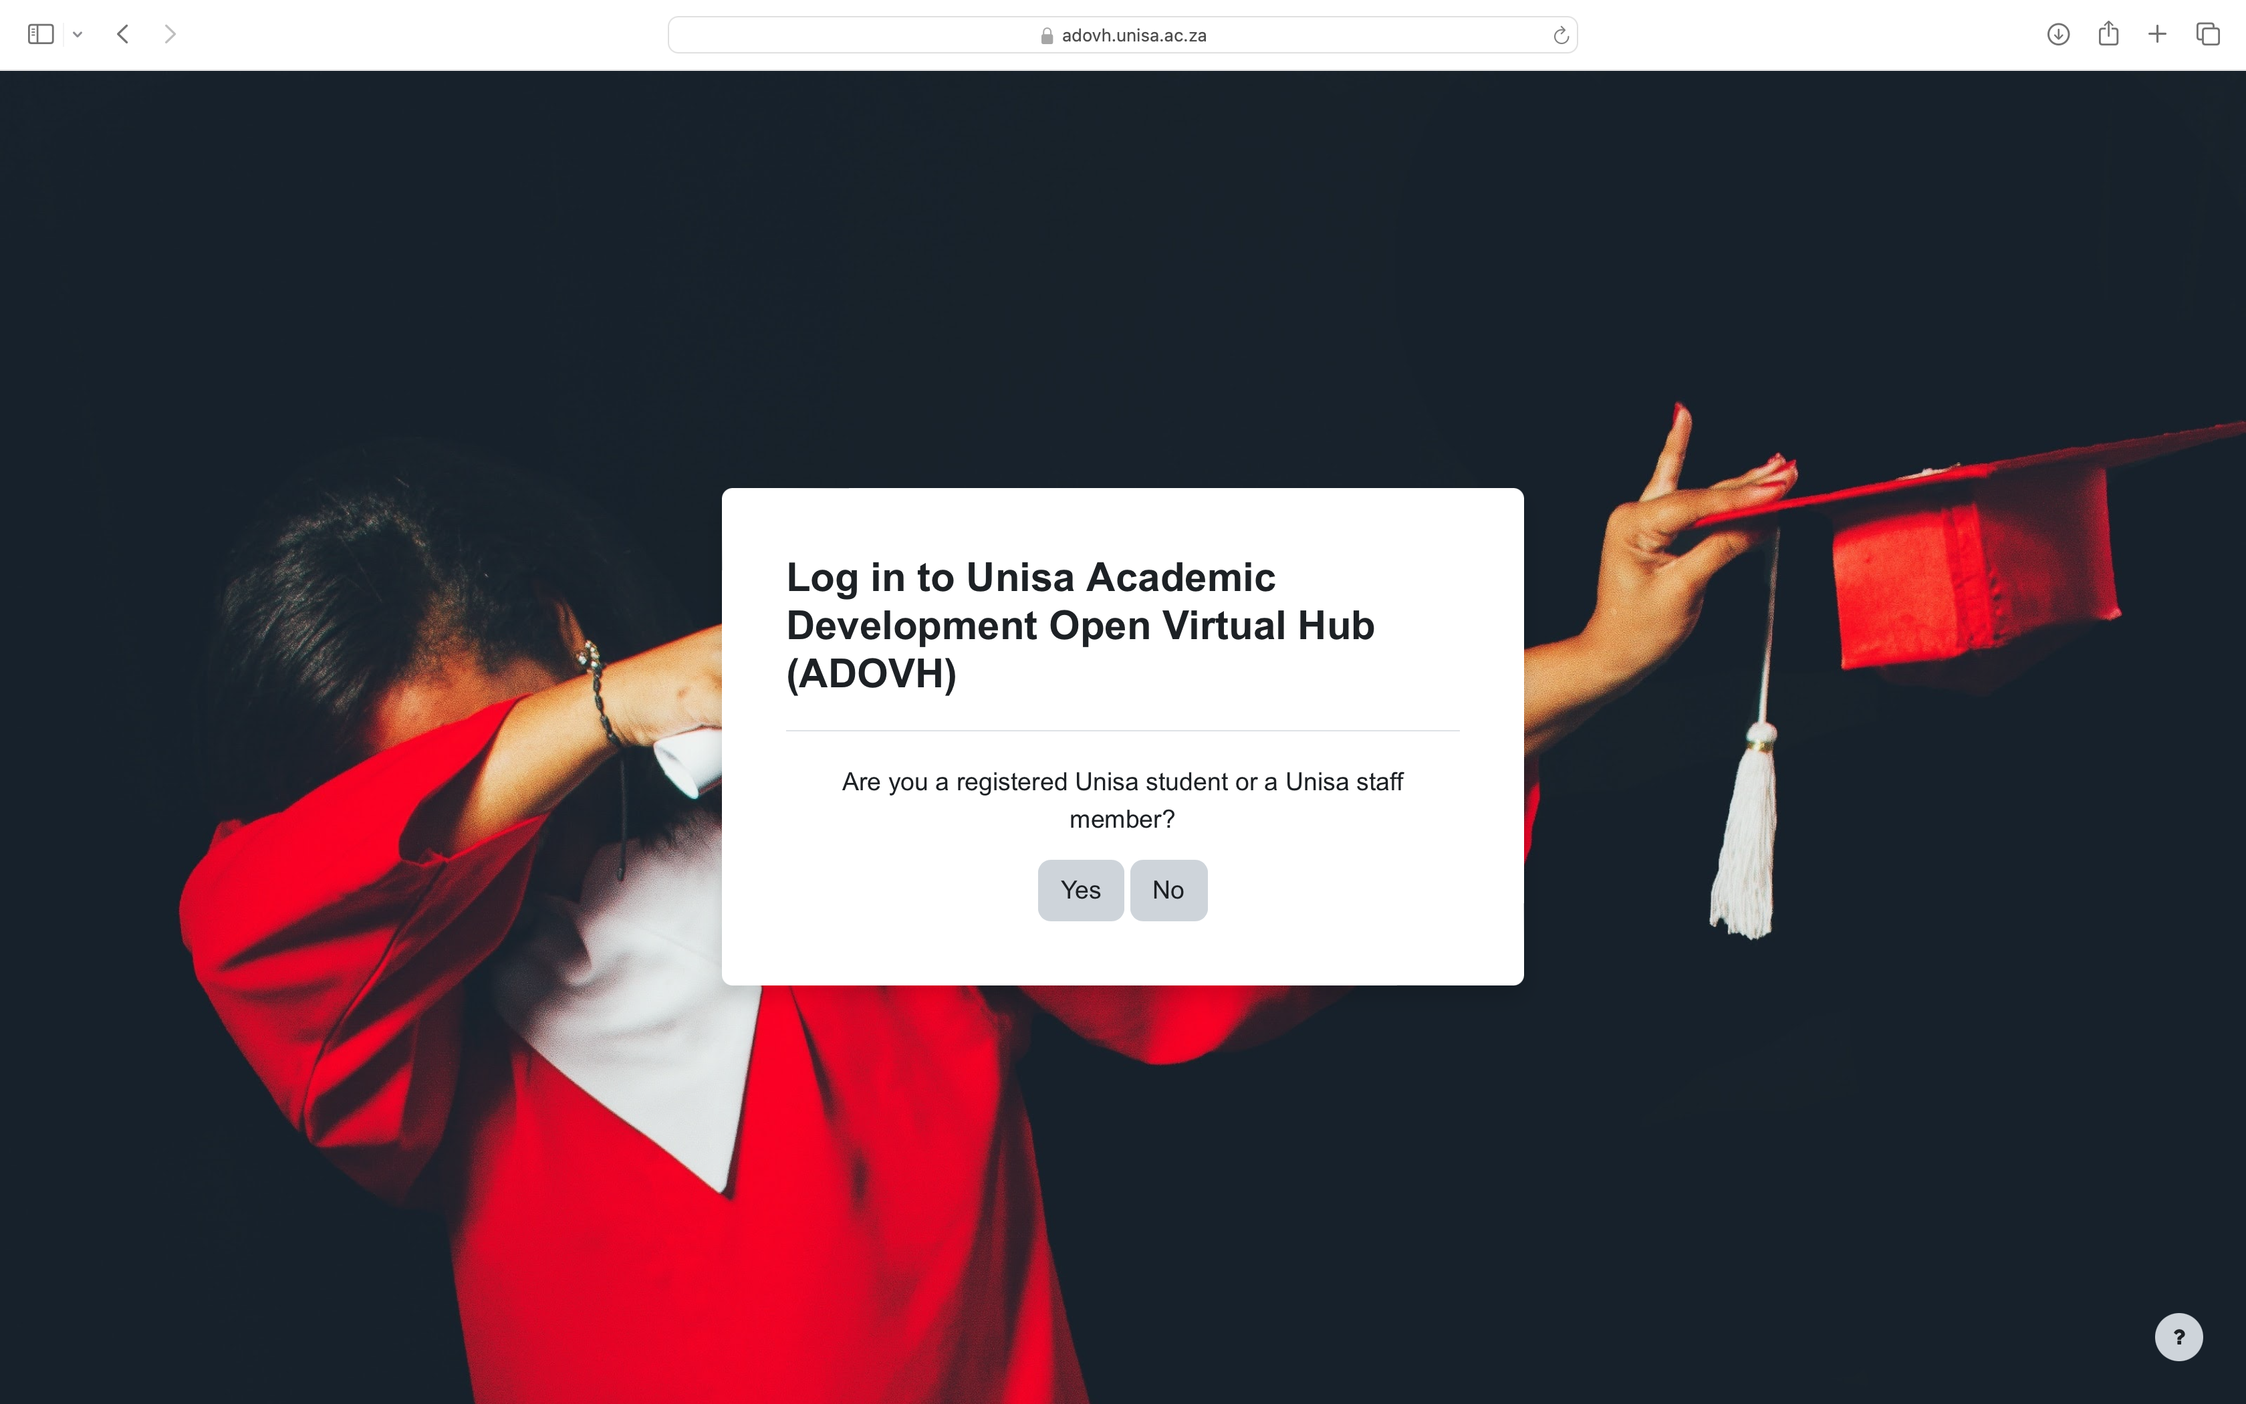
3.0 OPERATIONAL THINKING: INPUTS
Dedicated open learning platform (separate from the main LMS).
Students can log in with their university credentials or open an account.
Low-cost: Moodle (open source)
Cloud-hosting: scalable for more space when needed.
Mobile compatible.
Allows for innovation/ piloting without any interference on the main LMS.
Students are exposed to online learning before they come into the university – induction.
Potential for “Learning Paths” – Skills on Demand
PLATFORM

Slide 6
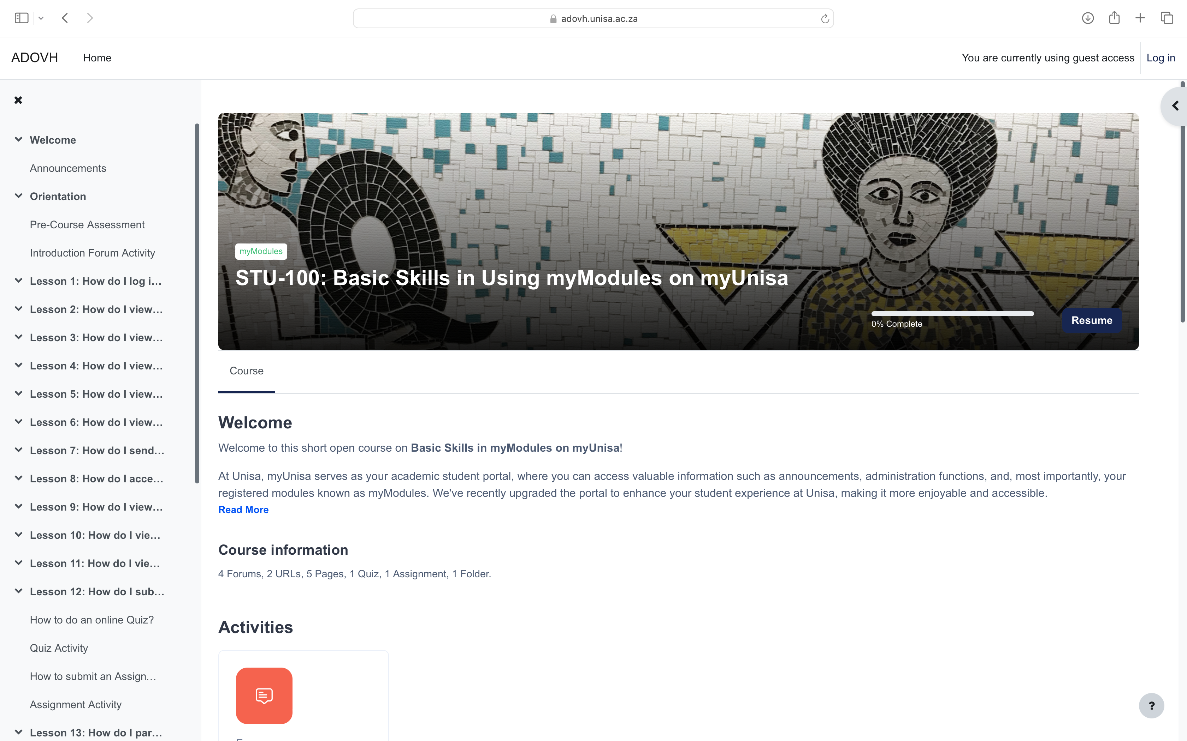
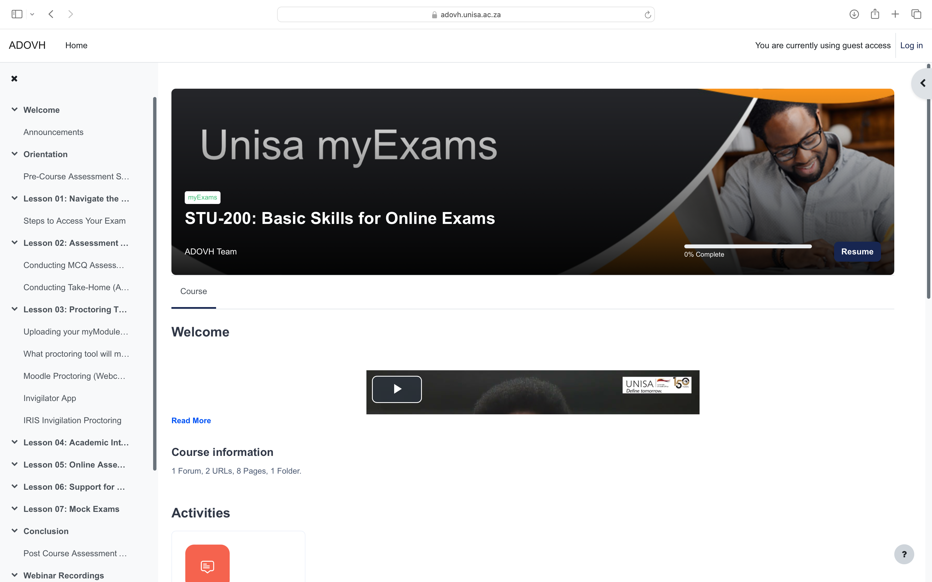
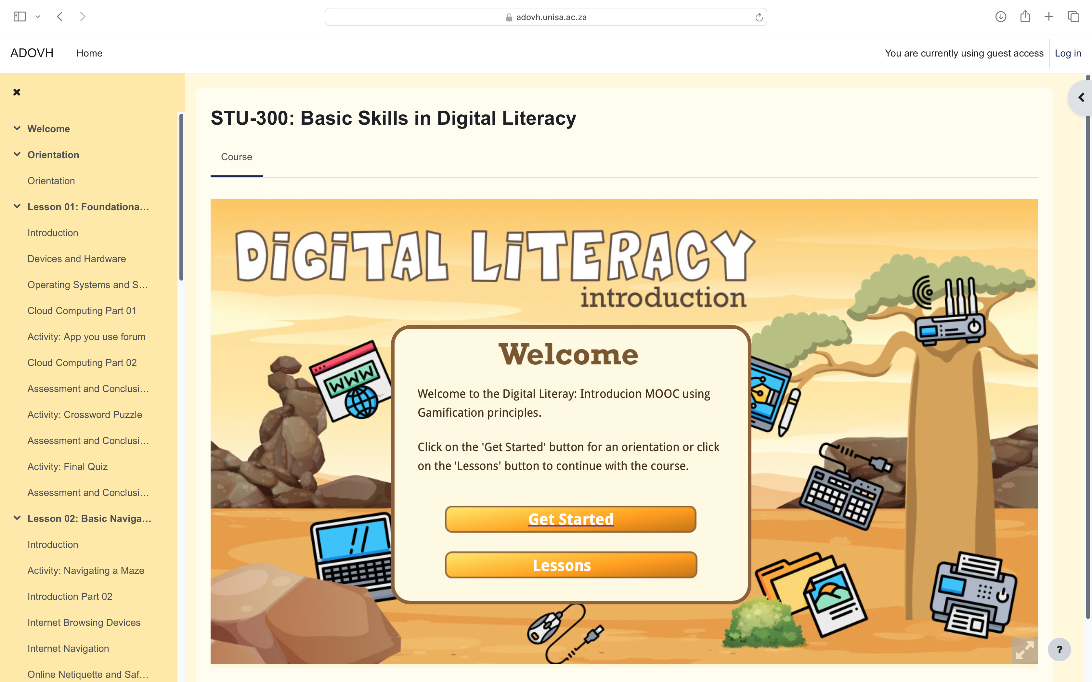
3.0 OPERATIONAL THINKING: INPUTS
Basic Skills in Navigating the Online Learning Platform
How to access the content.
How to post on forums.
How to submit assessments.
Basic Skills in Online Assessments (Exams)
Submitting assessments (online MCQs/ File Upload Assessments)
Proctoring Tools
Plagiarism / AI Detection Plug-in
OPEN COURSES
Fully Gamified Digital Literacy MOOC (foundational skills)
Leader boards
Activity-based learning

Slide 7
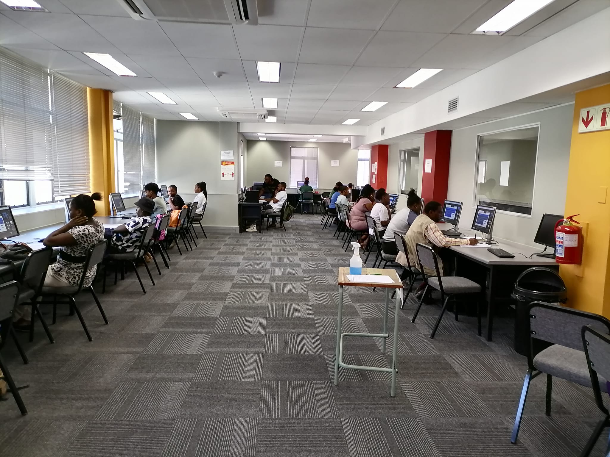
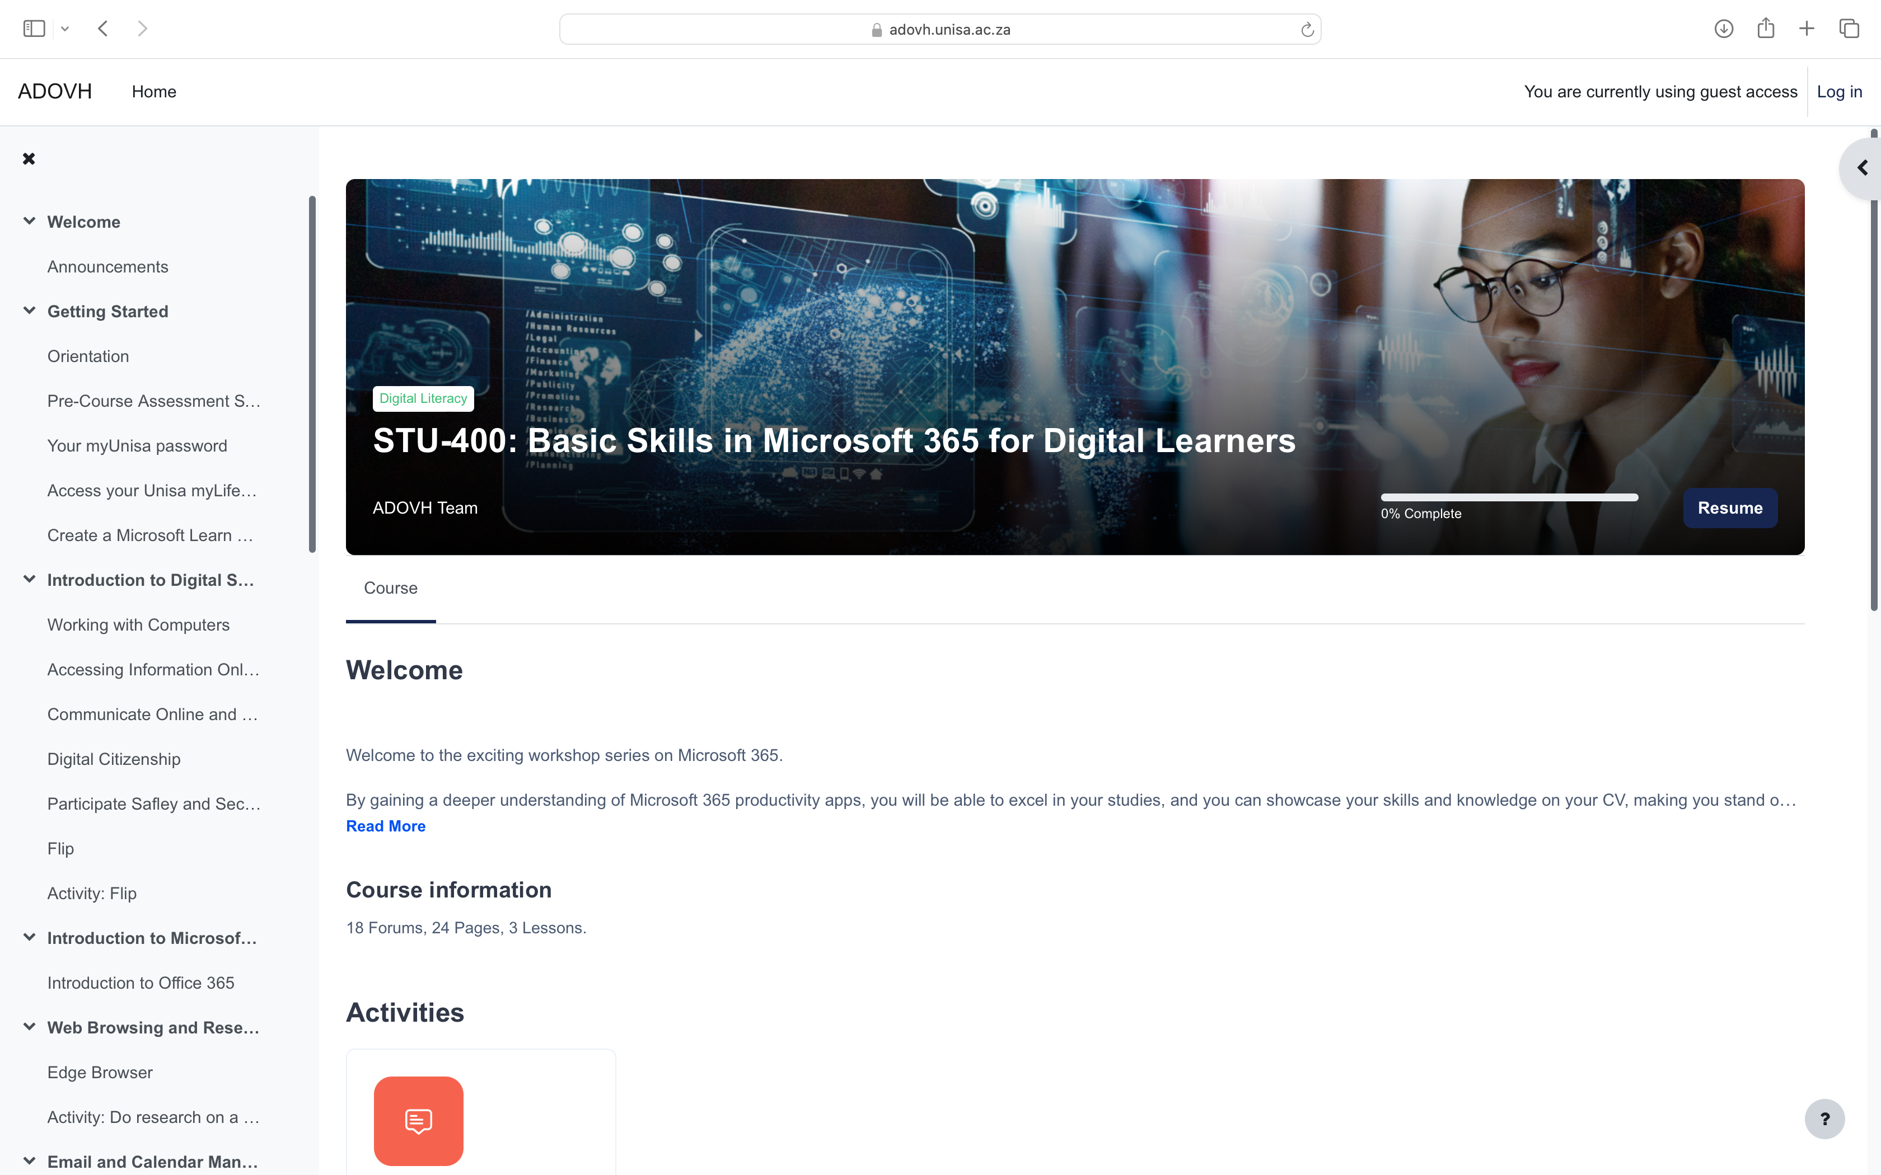
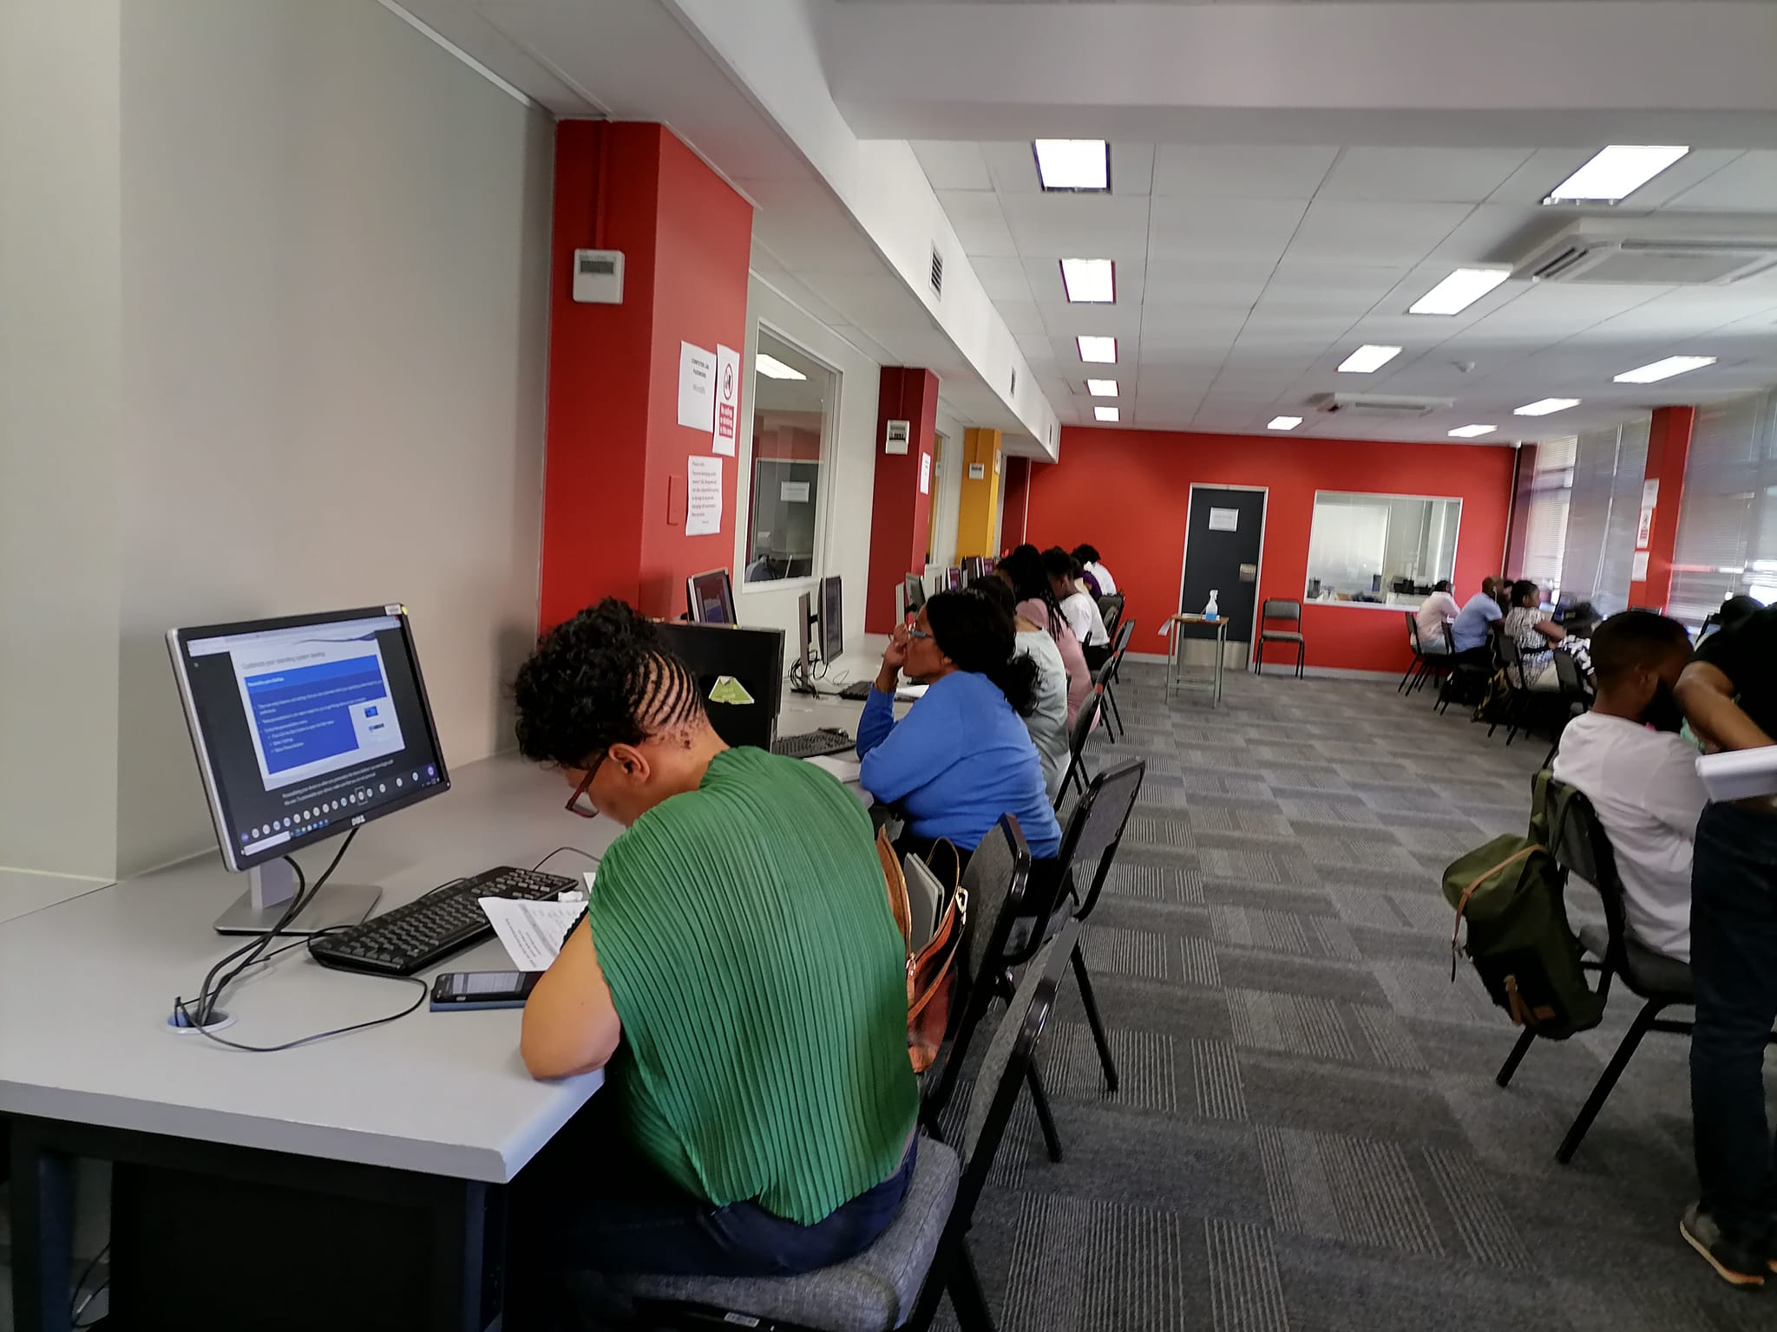
3.0 OPERATIONAL THINKING: INPUTS
OPEN COURSES
Basic Skills in Microsoft 365. Collaboration with Microsoft. Trained 20 000 students in Gauteng as a pilot in March 2023 (hybrid approach – online and face-to-face sessions)

Slide 8
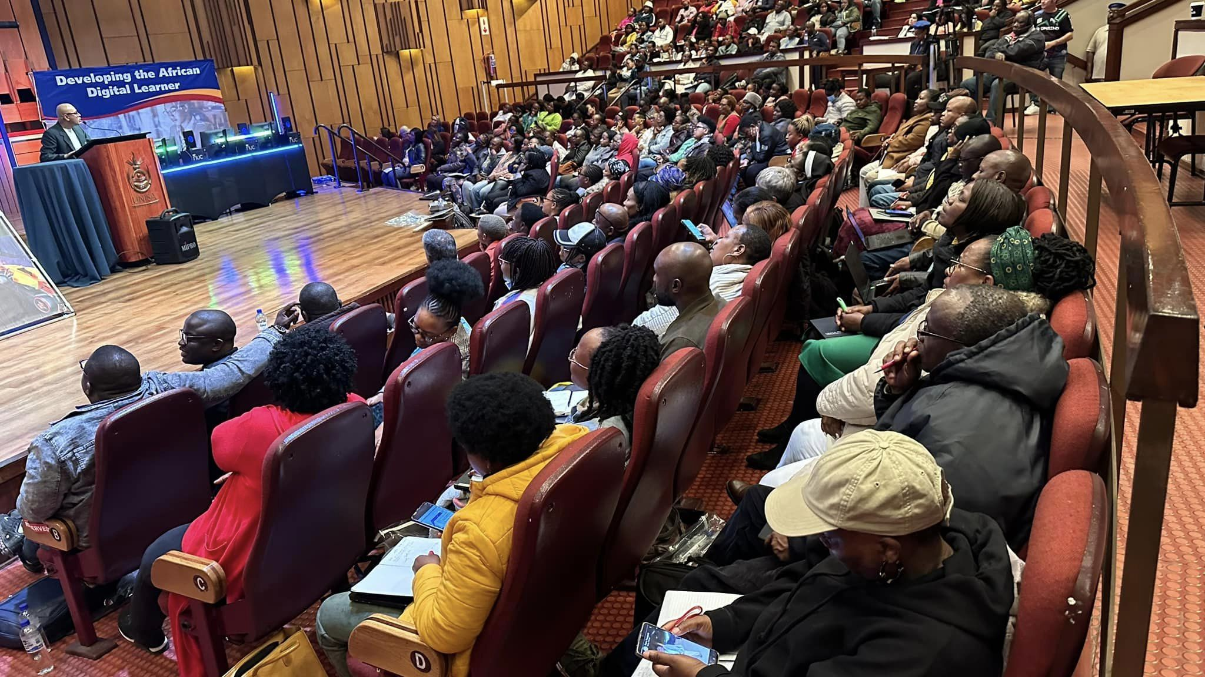
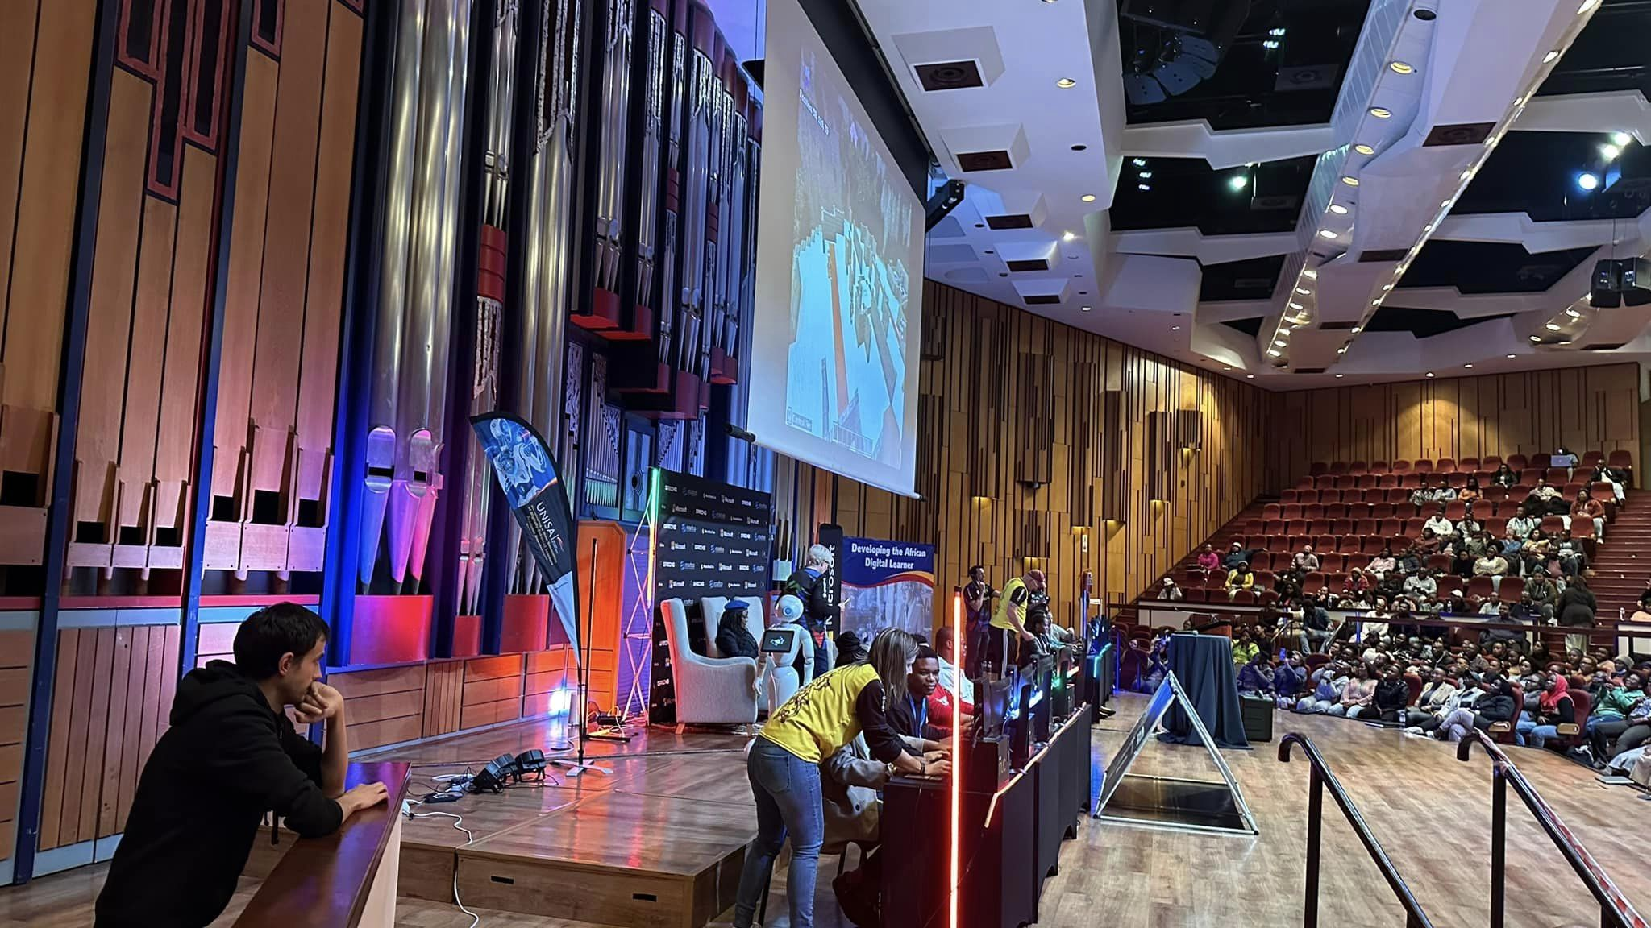
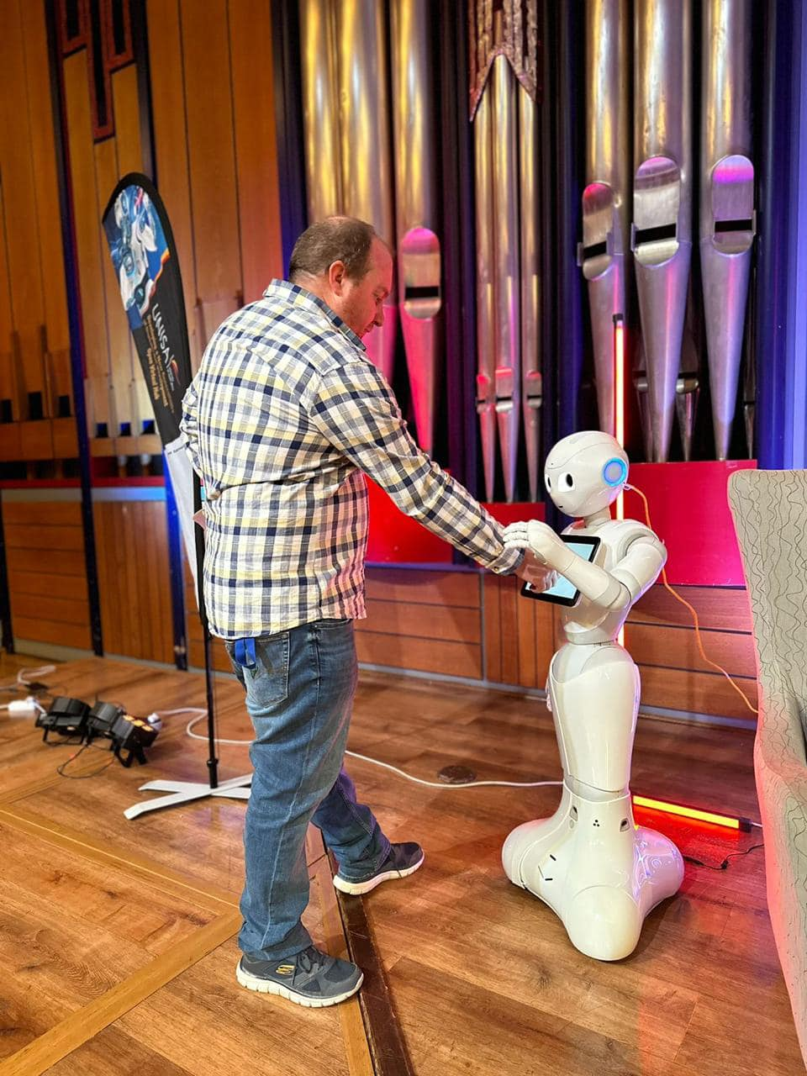
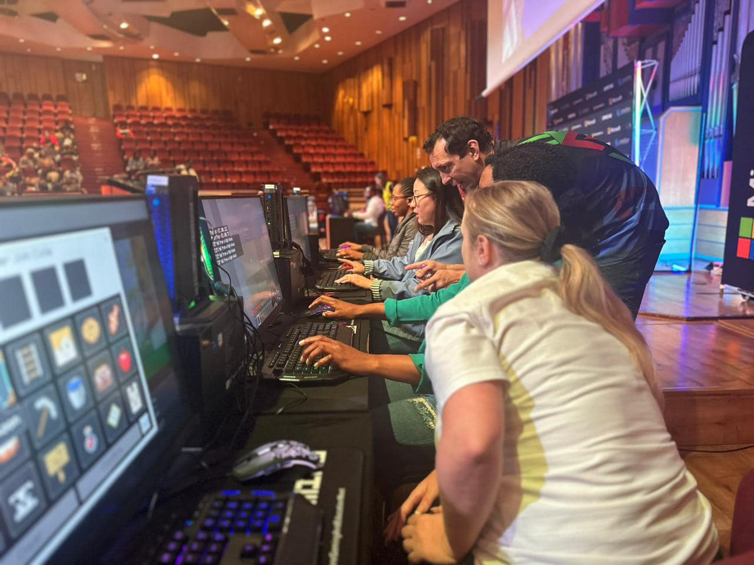
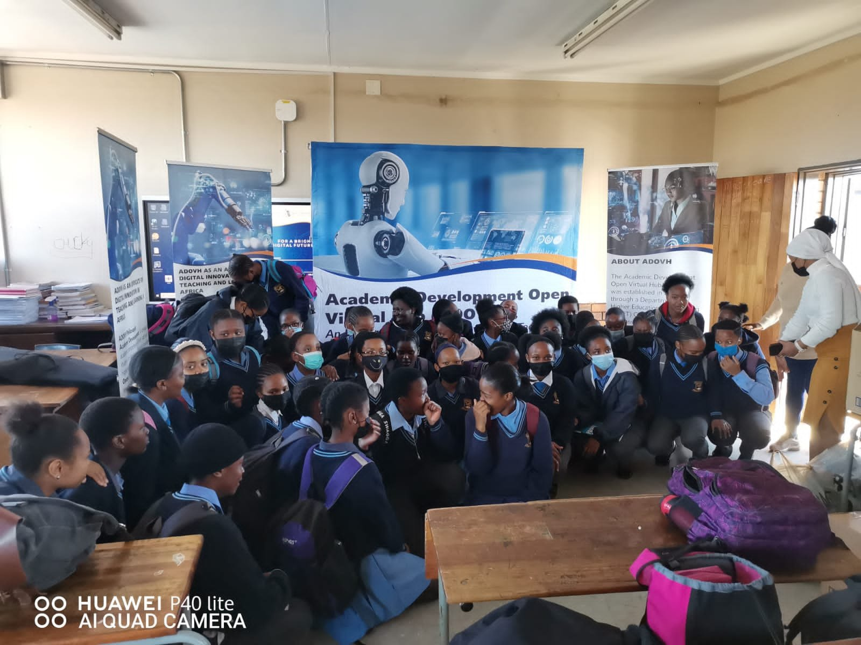
3.0 OPERATIONAL THINKING: INPUTS
OPEN COURSES

Slide 9
3.0 OPERATIONAL THINKING: OUTPUTS
OUTPUTS
2022: Semester 1: The first MOOC focused on Basic Skills in myModules on myUnisa (https://dtls-qa.unisa.ac.za/course/view.php?id=32130). In total, the MOOC had 95 530 unique visitors with an estimated 500 000 counts of activities on the site.

Slide 10
3.0 OPERATIONAL THINKING: OUTPUTS
OUTPUTS
2022 Semester 1: The map highlights the geographical coverage of students participating in the MOOC.

Slide 11
3.0 OPERATIONAL THINKING: OUTPUTS
OUTPUTS
The second MOOC facilitated by ADOVH focused on preparing students for the May/June 2022 online examinations – i.e., Basic Skills in Online Assessments (myExams). The total participation in the MOOC was 97 180 participants, with 649 49 counts of activities on the site.

Slide 12
3.0 OPERATIONAL THINKING: OUTPUTS
OUTPUTS
2022 Semester 1: In the map below, one can see the student coverage within South Africa.

Slide 13
3.0 OPERATIONAL THINKING: OUTPUTS
OUTPUTS
In addition to the MOOC, ADOVH created a mock exam site where students could familiarise themselves with the Multiple Choice Question (MCQ) and Take-Home (File Upload) exam formats and the proctoring tools used. ADOVH had 89 304 students complete the mock exams, with more than 2.90 million activities completed (students were allowed to take the mock exams multiple times).

Slide 14
3.0 OPERATIONAL THINKING: OUTPUTS
OUTPUTS
To further assist students, ADOVH created a series of Digital Learning Objects (DLOs) in short video clips (3-4 minutes). The graph below shows that these DLOs were accessed approximately 54 000 times by students. All live webinars and student blast sessions were recorded and uploaded online. The statistics below reveal that about 67 000 students accessed these recordings on YouTube.

Slide 15
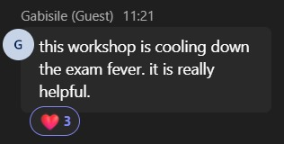
3.0 OPERATIONAL THINKING: IMPACT
IMPACT

Slide 16
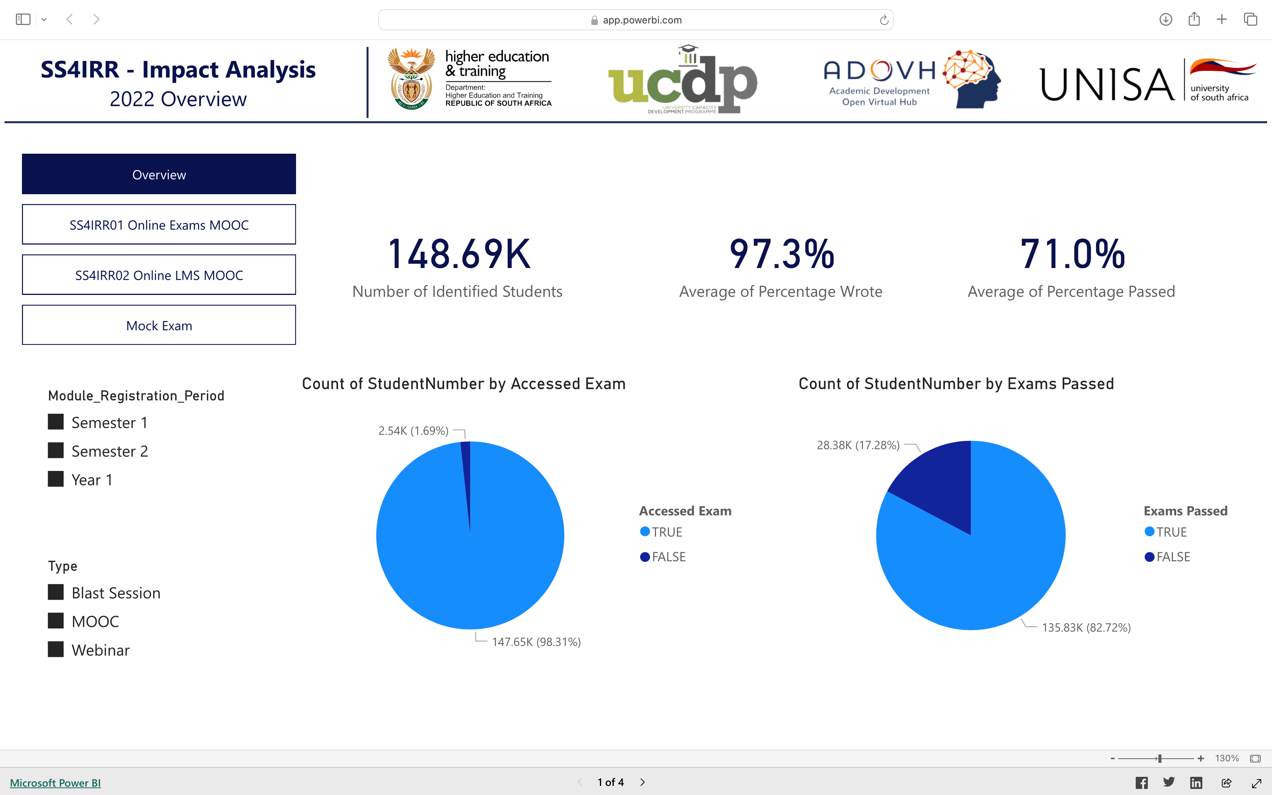
3.0 OPERATIONAL THINKING: IMPACT
IMPACT

Slide 17
4.0 LOOP THINKING: ONGOING PROCESS
AFRICAN STUDENT DIGITAL RESILIENCE PROGRAMME
AIM: Creating a cohort of digitally resilient students who can navigate a complex and rapidly changing education landscape.
METAVERSE
GENERATIVE AI
AI & ROBOTICS
What does it mean to be a student in a metaverse where the boundaries between reality and virtual are blurred?
How will this shape the learning and student support?
Graduate Productivity Skills
Implications of Generative AI – Evaluation as opposed to creation
AI Literacy (managing competency)
AI Metaliterary (managing knowledge/ epistemology challenges)
Fostering an immersive and engaged student experience where AI and Robotics can enhance student support.
Chatbots

Slide 18
THANK YOU

