Slide 1
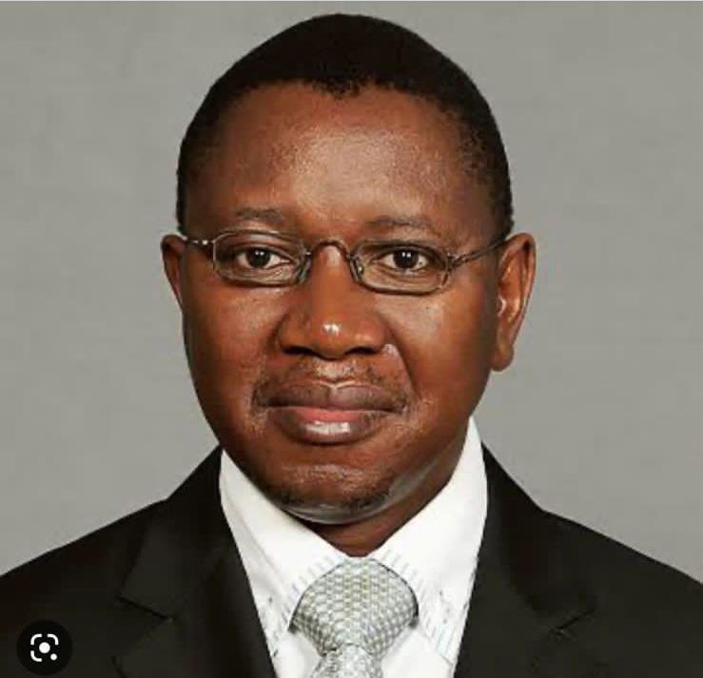
Symposium Overview (Including Objectives)
Presented by Prof Lalendle

