Slide 1
Higher Education in Transition: Relevance and Responsiveness
Prof Mpine Makoe
Executive Dean: College of Education
University of South Africa

Slide 2
Phoenecian alphabet
Printed press
Technology enhanced T&L
MAJOR DISRUPTIONS IN EDUCATION
10th century
14th century
21st century

Slide 3
Changes in Higher Education
Patterns of learning has evolved and is fundamentally different from the pre-digital era
Diversification of information sources, no longer do students rely on a single source of information in their learning journey
Lifelong learning and self-directed learning
Increased requirements for ‘new currency’ for higher education where problem-solving, critical thinking, basics skills, languages and digital literacy and skills.
New ways of acquiring skills are emerging and rapidly growing in scope and volume enabling students to acquire ‘alternative credentials’ – such as micro-credentials, digital badges an industry-recognized certificates
Higher learning is expanding beyond formal education through technology Driven networks of informal and non-formal learning opportunities.

Slide 4
Deficiencies in higher education
Lower return on investment for students
Reduced government funding
Mismatch of skills between graduates’ abilities and available jobs
Unpredictable labour market demand
Slow response from higher education institutions

Slide 5
Reflect
Rethink
Renew

Slide 6
Fitness of purpose
Fitness for purpose
Value for money

Slide 7
What are the key challenges that Higher Education policymakers, academic leaders, lecturers and students are facing in designing and delivering quality and relevant programmes?
What should be done to design and deliver relevant and quality programmes that are responsive to different learning needs of diverse groups of students?

Slide 8
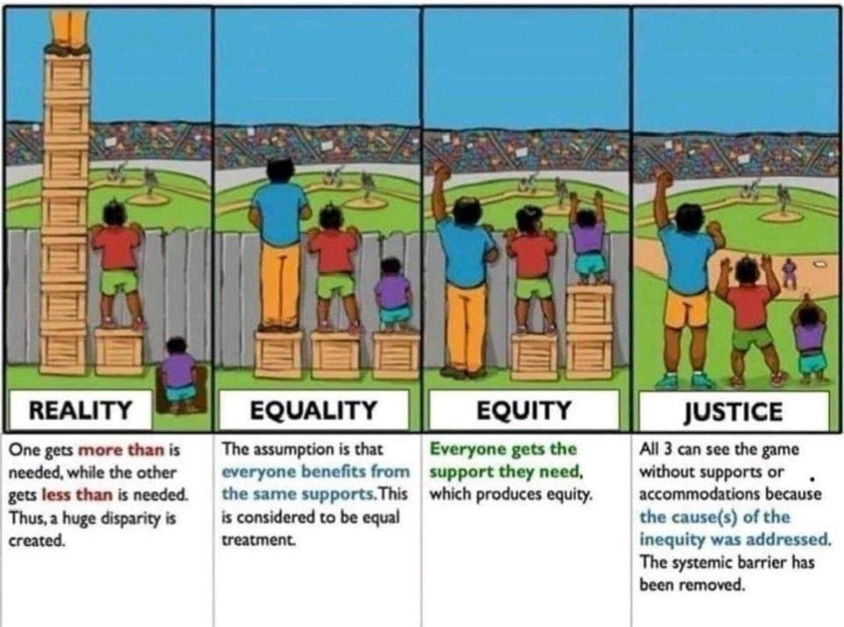
SOCIAL JUSTICE MANDATE

Slide 9
Reimagine higher education of the future
Rethink
Rethink regulatory frameworks to address technology-enhanced learning
Revisit
Revisit higher education policies and framework
Ensure
Ensure access to higher education agile and affordable higher education
Diversify
Diversify higher education provision
Consider
Consider a model that promotes credible and relevant provisions of both formal, informal and non-formal education in a way that complement and supplement each other.

Slide 10
Reimagine the Regional Model
Decentralise regions
Offer general and specialised academic programmes geared towards the economic development of the region
Provide student support services for students in the regions
Provide infrastructure and connectivity for students who live in marginalised communities
Interact closely with the industries in the region for work integrated learning

Slide 11
Ke a leboha
Siyabonga
Baie Dankie
Thank YOU

