Slide 1

Technology Mediated Assessments:
Lesson from Open University of Tanzania
By
Prof Elifas T. Bisanda
Vice Chancellor, Open University of Tanzania

Slide 2
INTRODUCTION
Traditional Assessment of learners, is labour intensive, time consuming and costly
It usually consumes lots of paper, requires involvement of many personnel, from setting questions, printing, Distribution, invigilation, collection answer scripts to the centre, organizing marking, compiling results, and final approval of results.
There is insecurity and prone to cheating and examimimation leakages.

Slide 3
The OUT Examinations Syndicate
OUT Established an Examinations syndicate in 2007, became operational in 2008 with core mandate of centrally coordinating and overseeing the management of:
  University Examinations for all levels: ND, UG & PG
  Students Results, Qualifications and Awards

Slide 4
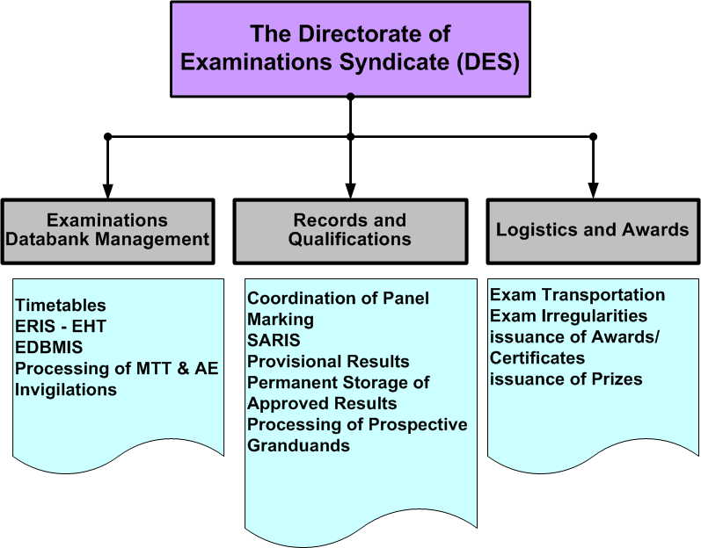

Slide 5
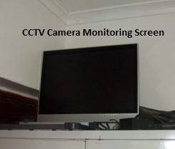
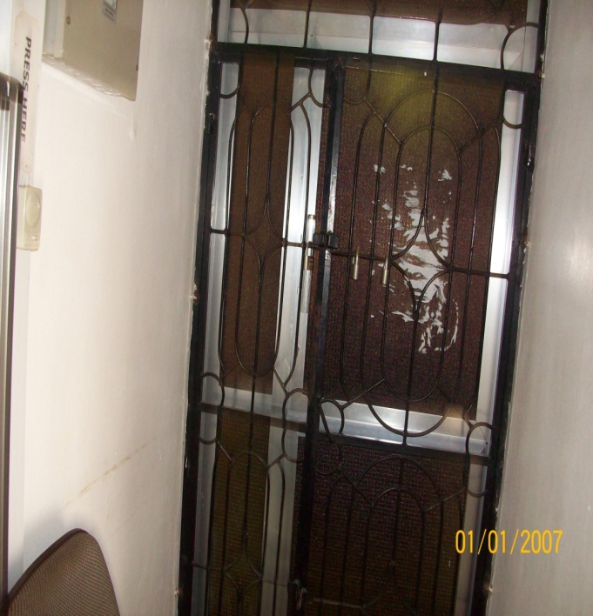
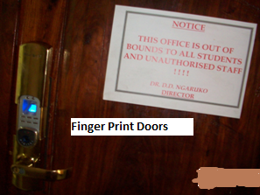
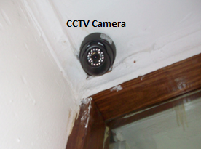
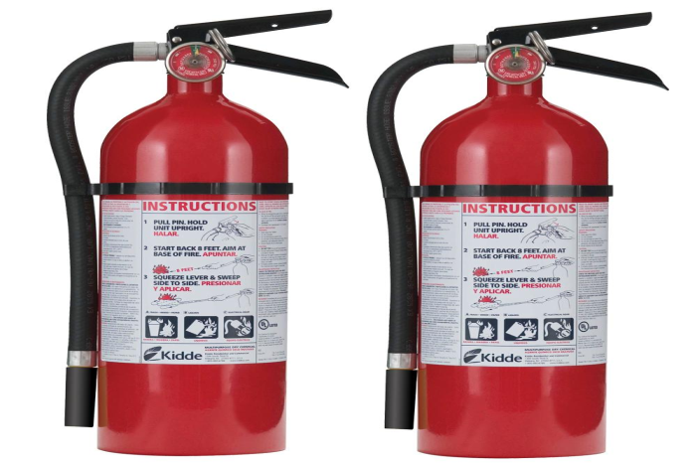
Physical Security
Operate under “out-of-bounds” status
Locked Room equipped with:
  Grilled Doors & Windows
  Finger Print Device in a main door
  CCTV Cameras
  Fire Extinguishers

Slide 6
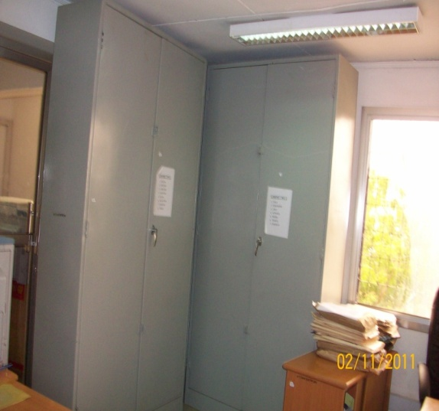
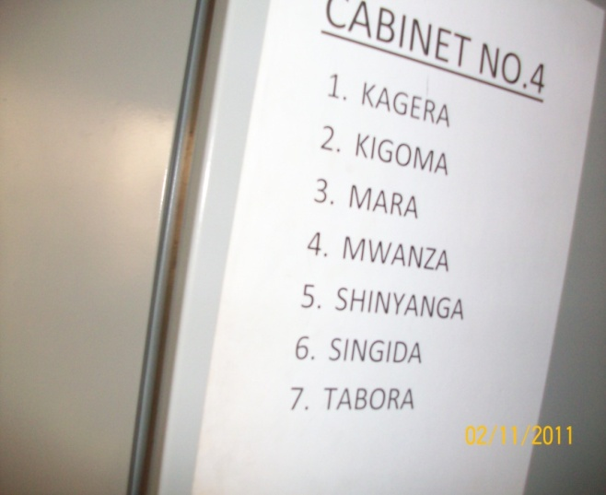
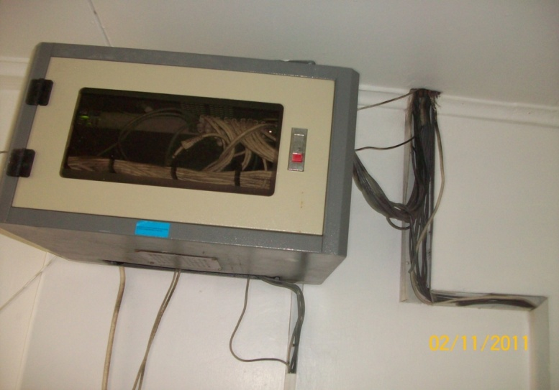
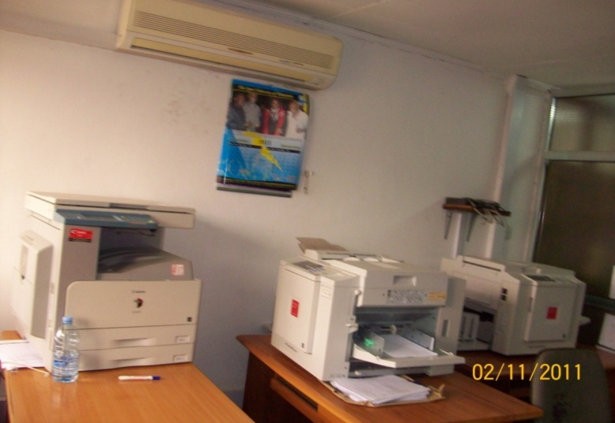
Storage Security & Isolations
Use of Locked Iron Safe Cabinets
Isolations
  External Disconnected LAN & Use of Standalone PCs
  Limited Staff Access (Currently Only 2)
  Controlled Printing Facilities

Slide 7
Logical Security
Course tutors have no control of examination papers of their own courses. The course tutor cannot leak exam to students as he/she does not know the contents of the exam paper for his/her course.
Systematic Random Selection of Questions controlled by in-built Software Algorithm
Increased number of possible sets of question papers that can be printed, hence reducing the chance of guessing which questions may be picked and appear in examination room.

Slide 8
Security in Questions Bank
Centralized DB with Annual Updates
Each ODEX course has 180 questions & 6 KAs
Distinct question papers can be generated:
  ¹⁸⁰C₆ (= 43,424,719,800) ODEX-AE and ⁹⁰C₃ (=117,480) for ODEX-MTT with repetitions.
  30 MTT Sets and 60 AE Sets without repetitions (100% distinct sets)
Reuse Policy is 5 years/Change of Curriculum

Slide 9
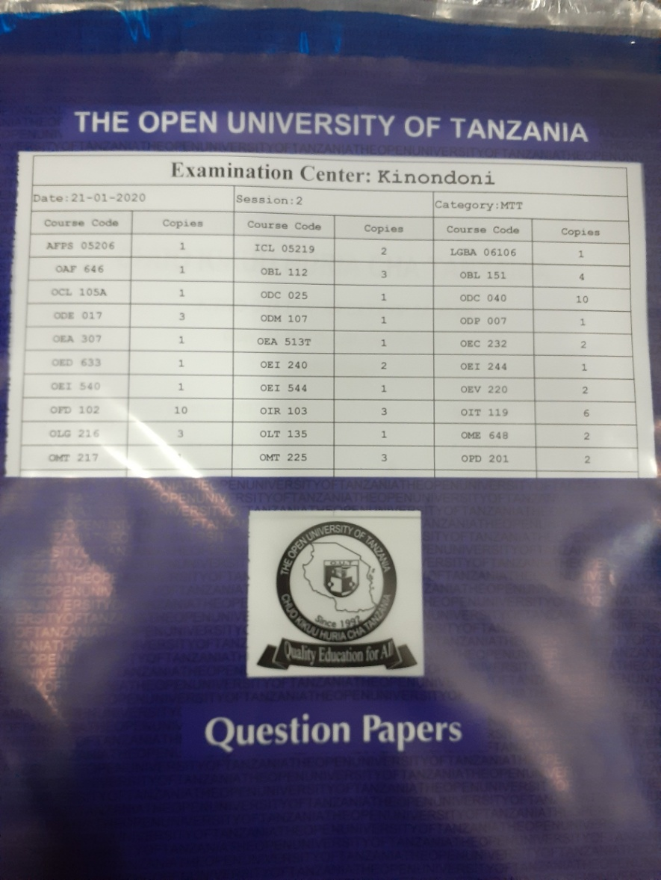
Security in Question Paper
Watermarked with Time of Print (ToP)
PDF Security using Alphanumeric Passwords
Online File Transfer
Password through Mobile Phones (30 Mins)
Sealed Non-Reusable Security Envelopes

Slide 10
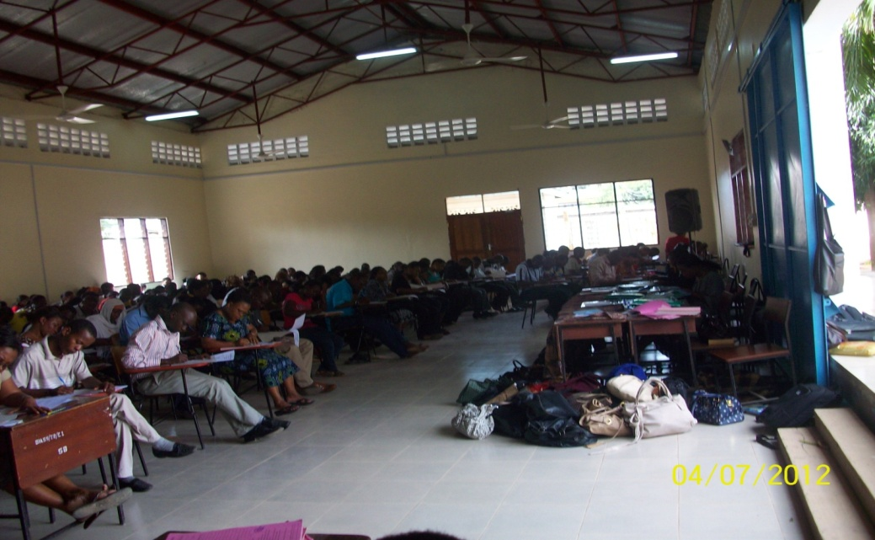
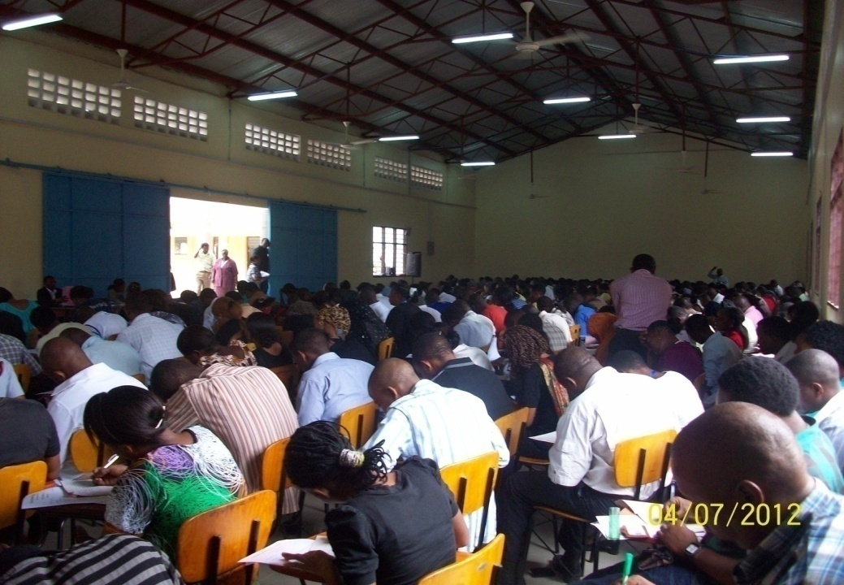
Invigilation Security
Comprehensive Master List
Well defined Sitting Plans
Students Identification:
  Examination Hall Ticket (EHT) & Other IDs
Involvement of (Half-Armed) Intelligence Officers
Vetted Invigilators
Centrally Coordinated from DES

Slide 11
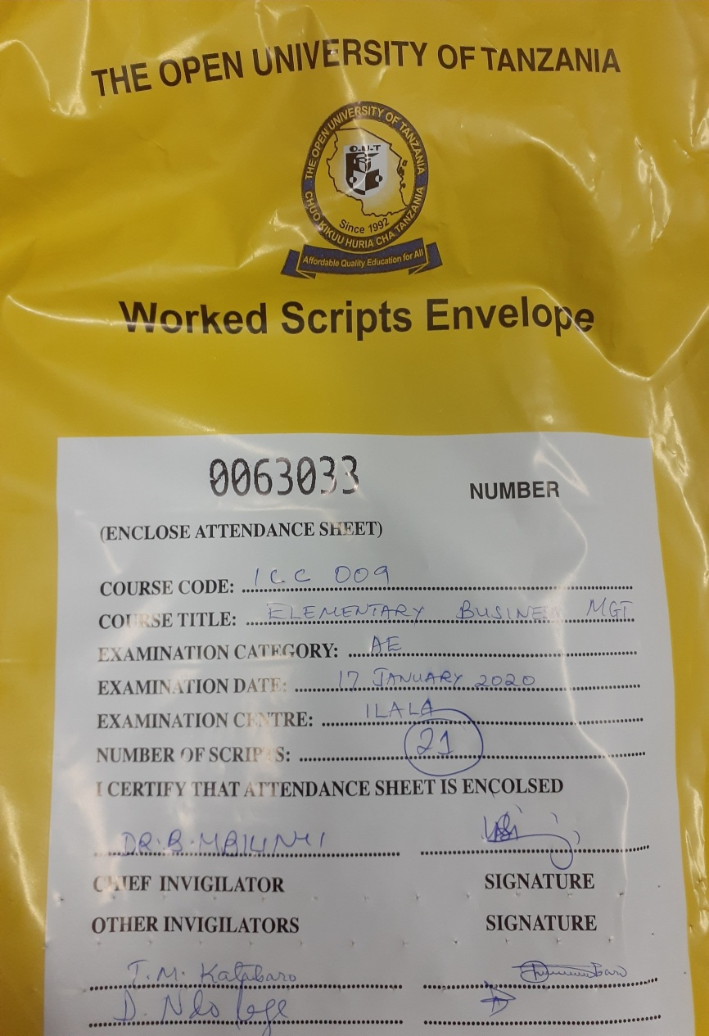
Packing Process of Worked Answer books
Use of System generated Packing lists (Center, Course, Exam Category & Registered Candidates)
Use of Non-Reusable Worked Scripts Security Envelopes
  With serial recorded numbers
  Signed by Chief Invigilator & 3 Other Invigilators

Slide 12


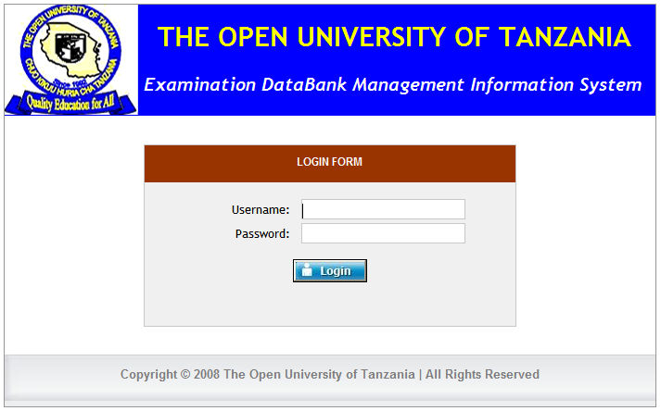
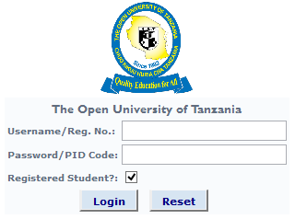
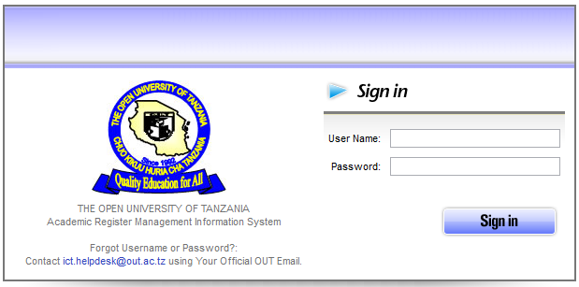
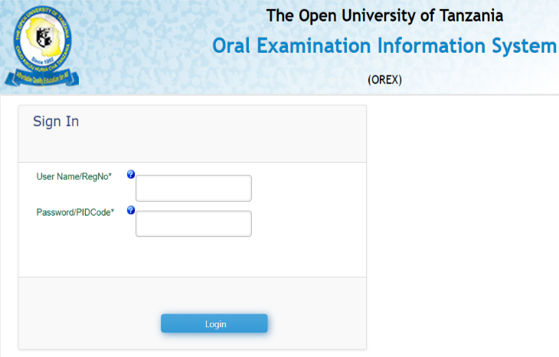
Automation Process MISs
ERIS-Examination Registration System
EDBMIS-Exam Databank Management System
ODEX-On Demand Examination System
SARIS-Student Academic Register Information System
OREX-Oral Examination System
OREX Software

Slide 13

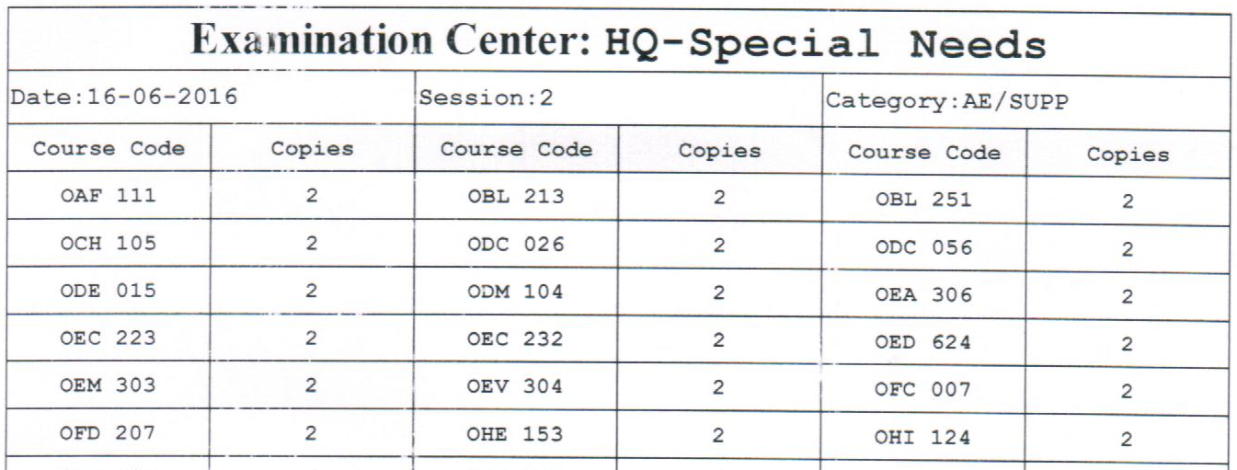
Customer Care & Support
Students with special needs
  Examination Room for disabled students
  Font Size, Type, etc
REPORT ABUSE
CASH FREE ZONE
Transcript Issuance: Within 24 Hours
Email Response: Max of 2 days
User-friendly Students Clearance & Certificate Collection

Slide 14
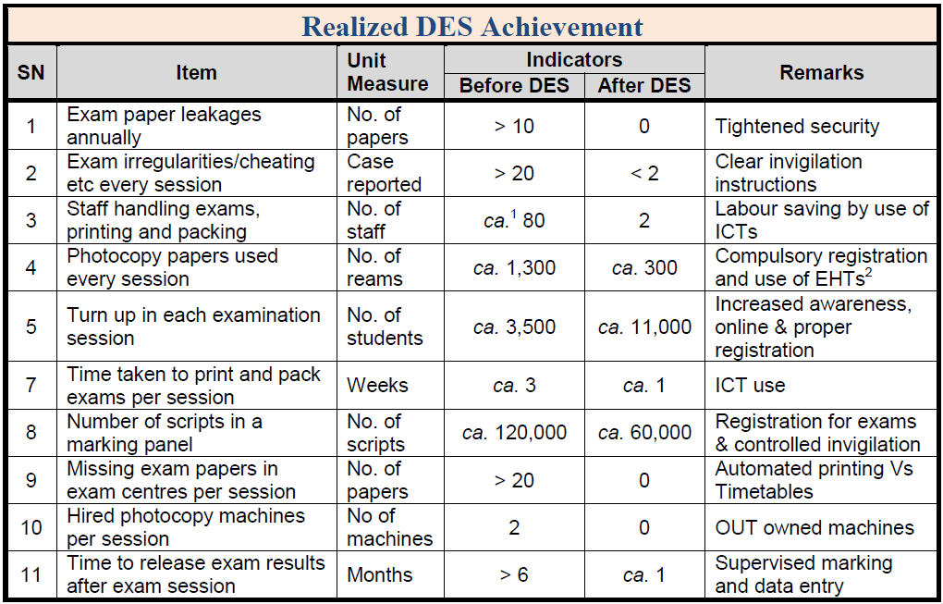
Realized DES Achievements

Slide 15
Other Unquantifiable Achievements
Improved Quality of exam papers including Uniformity in Layout - ODEX Question Paper Design (Blueprint) for MTT (2 Hours) & AE (3 Hours)
Option I - Higher Level Questions Only | Description – 3 Questions each from KA I, II and III. Student answer 2 questions only with each carry 50%.
Option II - Lower Level Questions Only | Description – 4 Questions each from Knowledge Area I, II and III. Student answers ALL questions with each carries 25%.
Option III – Both Lower Level and Higher Level Questions | Description – 3 Questions each from Knowledge Area I, II and III. 2 questions are lower level and 1 is higher level. Student answers ALL questions with each carries lower level carries 25% and higher level carries 50%
Option I - Higher Level Questions Only | Description – 6 Questions each from KA I, II, III, IV, V, and VI. Student answer 4 questions only with each carry 25%.
Option II - Lower and Higher Level Questions with Sections A and B. | Description – Section A consists of 4 lower level questions each question from different knowledge area (I to VI). Each question carries 10% totaling to 40% of section A. Student answers ALL questions from this section. Section B consists of 5 higher level questions each from different knowledge area (I to VI). Student selects 3 questions out of 5 in section B. Each question carries 20% totaling to 60% of section B.

Slide 16
Unquantifiable Achievements…
Improved quality of invigilation and rapid response from invigilators
Provision of a master list of all expected candidates for each exam session
Increased discipline by staff handling examinations
Increased confidentiality of examinations by both staff and students
Increased Exam Sessions (ODEX)

Slide 17
Unquantifiable Achievements…
Improved work environment to academic staff
One Information Center (DES) for exam regulations by students and staff
Improved quality customer service to students and staff.
Increased tuition fee payments by students due to controlled entry in exams.
Early feedback to students through early return of TT scripts.
Automation of DES operations

Slide 18
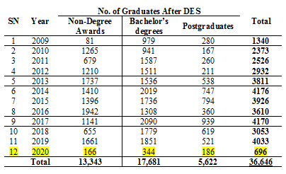
Increased Graduates Rate
Source: OUT Facts & Figures & Graduation Book 2009-2020

Slide 19
ORAL EXAMINATION SYSTEM (OREX)
In 2020, Most education institutions were closed due to Covid-19. OUT did not close as its course delivery was already online.
However, OUT students could not assemble to write exams. Instead, the University established an online oral examination system – OREX.

Slide 20

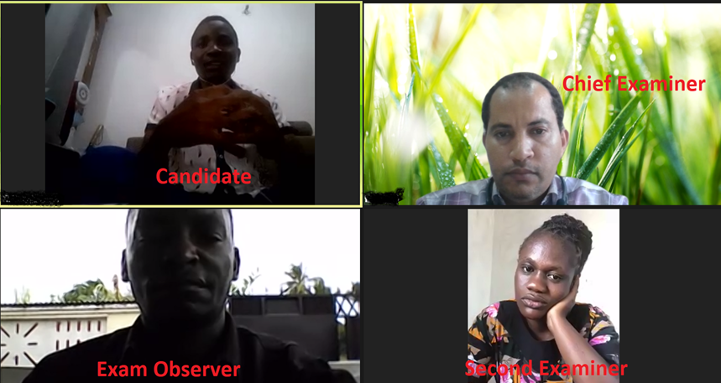
ORAL EXAMINATION SYSTEM (OREX)
Virtual Exam Hall (i~Room)

Slide 21
Realized Strengths of OREX
More objective than Written Exams.
Highly Flexible, Examiners & Candidates can take OREX from anywhere
A very Good Measure of someone's Understanding of a Subject.
Purely Open & Online Assessment Model.
Comply well with Covid-19 Social Distancing Order.
Save Time and Resources.

Slide 22
Realized Strengths of OREX
Random Allocation of Examiners to maintain high level of Anonymity
Examination Timetable is UNIQUE for Examiner & Student
Opportunity for Examiner to get Instant Feedback from Students
Automated Questions & Marking Scheme.
Question Paper is generated on Exam Date & Time.
Questions are Comprehensive & Integrated.

Slide 23
Realized Strengths of OREX
Follow-ups Questions probe student to provide elaborative answers.
On the Spot Marking, Question Paper with inbuilt Marking Scheme.
Help student to build Confidence, Communication Skills.
Assess Creativity Aspect of the Subject, Application, Problem Solving, Knowledge, and Understanding of the Learning Outcomes.
Improve ICT Skills <<Smart Devices & Online Collaboration Tools>>

Slide 24
OREX System Functionalities
Facilitate Registration & Examination
Zoom Link is shared through Software
Students generate OREX Visa Card
Pairing of CE/SE/EO and Candidate is automated and randomly determined by Software
Question Paper is randomly generated from the Software
  Visible on Exam Date & Time of Print (ToP)
  With 2 questions: Q1 from Part1, Q2 from Part2

Slide 25
OREX System Functionalities
Marking Scheme is randomly generated from the software in form of Model Answer
OREX Marking in instant before close of session
Examination Timetable is unique to each student and Examiner.
Provides efficient Session allocation to both Examiner & Candidate based on the user workload.

Slide 26
Role of Examiners-CE & SE
To create ZOOM Link and share to Candidate
(45 Min + Unlimited Time)
CE will ask Question 1 & SE will ask Question 2
  CE & SE will mark both questions.
  To record OREX session (MP4 Files) and send to HoD on daily basis. Coursecode_RegNo_Date eg. OCP100_U18-545-1111_040620 (Exam Appeal)
HoD will compile & send all OREX files to DES on weekly basis. (One Copy of MP4 Files should be kept at Dept)
EO will observe session and write observer’s report

Slide 27
How to Ask Oral Questions
Probe student to provide elaborative answers.
Useful sample phrases for Examiner:
  Could you elaborate?
  Is there anything else published about this topic?
  Would like to expand your answer?
  Are there any other different lines of thought on this topic?
  Could you be more specific about “X”?
  You previously mentioned “X”, could you elaborate your thoughts on this?
  Would you like us to repeat the question?

Slide 28
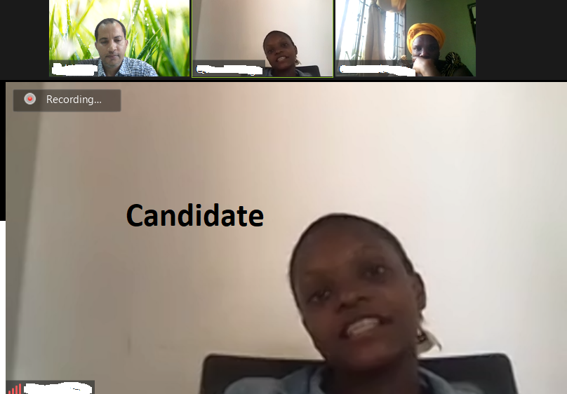
Positive Experiences
New Experience & Unique innovation
  OUT can innovate and implement ideas
  Applied “Construction by Design”
Helped to get staff to know each other (HQ/RCs)

Slide 29
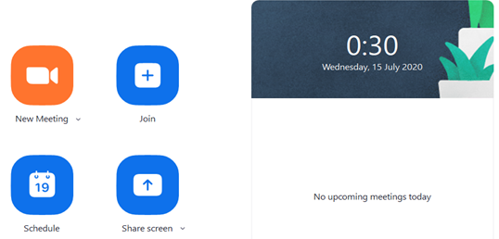
Positive Experiences
Staff trained on core issues:
  Technical or Technology Training by improving staff skills on the use of web system (OREX) in real-time environment.
  Soft Skills Training through use of audiovisual conferencing tool (Zoom facility).
  Team Training due to OREX structure of CE/SE/EO.
  Oral Assessment skills.

Slide 30
Realtime test for IT Infrastructure Strength (Staff & Students login concurrently)
A special opportunity for course tutors to brush up with their courses
Participatory Exercise (Almost all academic staff were engaged in invigilation, marking.
Quick recovery from fear, panic and technophobia
Student confidence for oral interview increased

Slide 31
Conclusions
Technology improves the security of examinations and reduces cheating
Technology reduces considerably, the number of people in the entire examination process
Technology allows examinations to be availed any time (On-demand), thereby increasing graduation rates.
Oral examinations are the future mode of assessment when network speeds will be increased and latency reduced through 5G.

Slide 32
Thank You
For Your Attention

