Slide 1
Policy Shifts in Higher Education: Online Learning
Professor Romeela Mohee Commissioner
Higher Education Commission, Mauritius
04 October 2023

Slide 2
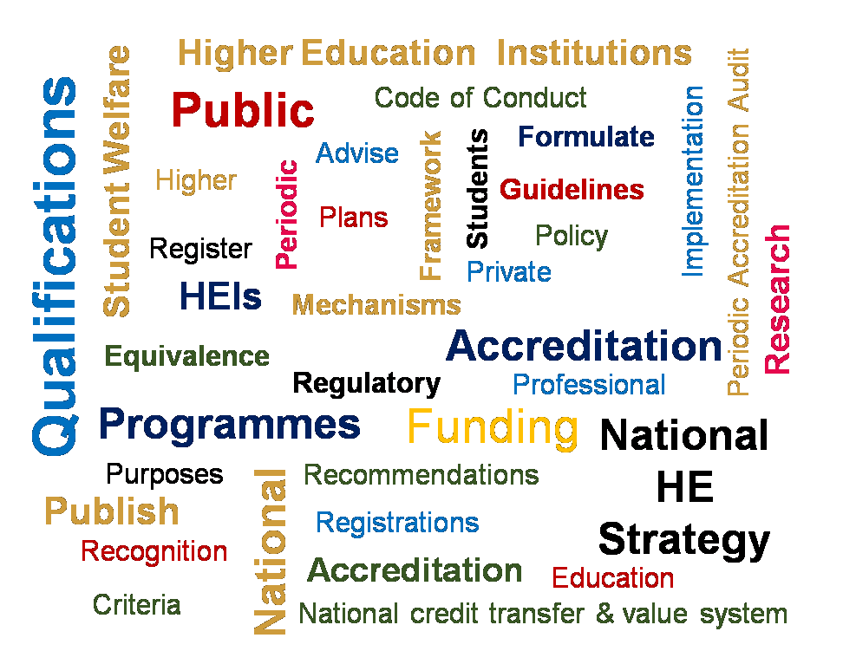
The Higher Education Commission
HEC Apex Regulatory Body for Higher Education, established in 2020
Oversee 7 public Universities, One Open University and 40 private Higher Education providers
Formulate and publish policies and criteria for the registration and accreditation of institutions offering higher education
Support and facilitate the implementation of the national higher education strategy of the Government

Slide 3
Overview
Higher Education in Africa
Impact of COVID 19 on higher education
Technology in higher education
Open Universities
Policy shifts
Online learning
Micro credentials

Slide 4
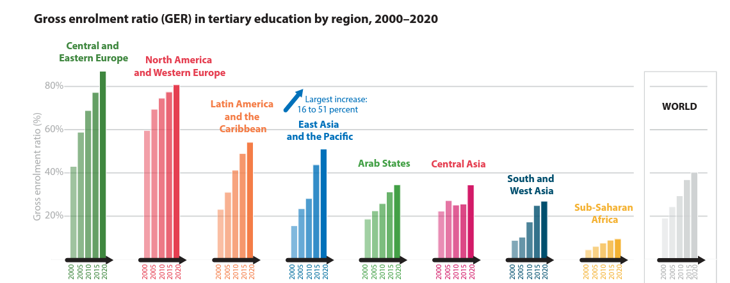
Higher Education in Africa
With 48 countries and a population of over 1 billion, Sub-Saharan Africa (SSA) is one of the largest regions in the world
Gross tertiary enrolment ratio in Africa is 9.4%
World average of 38%
Countries | Gross Enrolment%
Mauritius | 47.08
Botswana | 24.73
South Africa | 24.24
Seychelles | 17.3
Namibia | 27.26
https://uis.unesco.org/sites/default/files/documents/f_unesco1015_brochure_web_en.pdf
https://www.wathi.org/sub-saharan-africa-tertiary-education-the-docs-world-bank-december-2020/

Slide 5
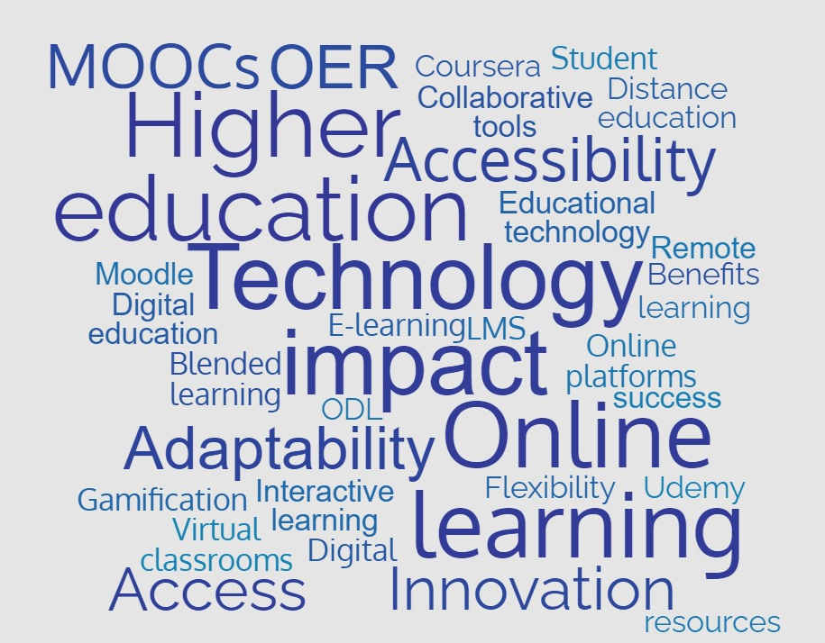
Technology in Higher Education

Slide 6
UNESCO Report:
Impact of COVID 19 on Higher Education
Access
International mobility
Widening inequality
The impact of COVID-19 on enrolment varies by regional and income levels
Mobility took a major hit, affecting students; virtual mobility could compensate or replace physical mobility.
The mixed impact of the pandemic on university finance highlighted on the exacerbation of inequality in higher education.
University staff
Disruption of research and extension activities:
Transition from higher education to work
Despite the closure of many universities, the impact of COVID-19 on university staff compared to the previous academic year is limited
The significant reduction of job opportunities makes the transition from higher education to the labour market more difficult.
COVID-19 caused suspension and cancellation of teaching and research activities globally.
The major impact of COVID-19 on teaching and learning is the increase in online education.
The hybrid mode of teaching
https://www.unesco.org/en/articles/new-unesco-global-survey-

Slide 7
Technology Driven Higher Education
In the ‘new normal’, digital and hybrid delivery has permeated higher education systems across the world has become the norm.
We must recalibrate not only their teaching but also their infrastructure and culture.
Shifting Pedagogies
Technology
Transitioning from traditional roles of teachers and concept of teaching to new roles of teacher and teaching accompanied by innovative pedagogy and educational technologies
Transitioning from expensive educational software and digital devices to more affordable but innovative devices
Policy
Capacity

Slide 8
Technology in Higher Education: Benefits
Accessible learning
Personalized learning
Technology can enhance learning accessibility through assistive tools like text-to-speech, speech-to-text, and mobile/online platforms for flexible learning
Technology can personalize learning through adaptive content and analytics for individual progress and feedback
Promoting critical thinking and citizenship
Advancing research and innovation
Higher education fosters critical thinking, informed citizenship, and positive community impact.
Data-driven
decision-making
Higher education drives research and innovation, fostering solutions to global challenges like climate change, disease, and poverty.
Technology aids data-driven decision-making in higher education through analytics for planning, policy-making, and enhancing student performance

Slide 9
Open Universities

Slide 10
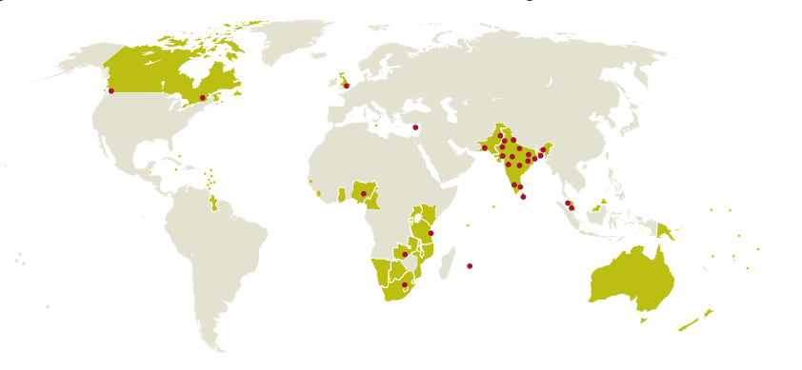
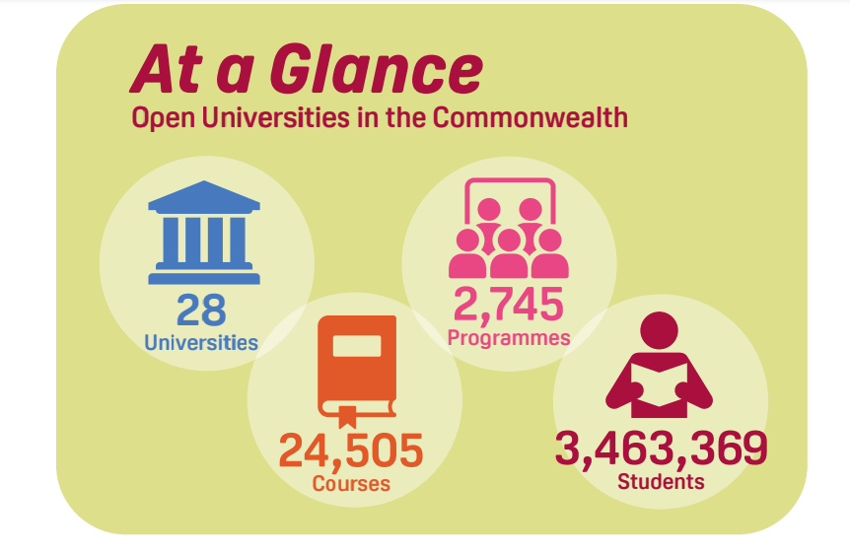
Open Universities in the Commonwealth
Teaching and Learning in Open Universities
Teaching and Learning Materials: Use a mix of online and printed resources, with a focus on(OER) and quality assurance measures.
Technology-Enabled Learning: Ensure content accessibility through OER and leverage LMS with interactive features and various tools.
Assessment: Employ continuous and diverse assessment methods, including online exams with integrity measures.
Learner Support: Emphasize staff support, specialized assistance, and tailored resources for students, including those with disabilities. Multiple communication channels and media platforms are used.

Slide 11
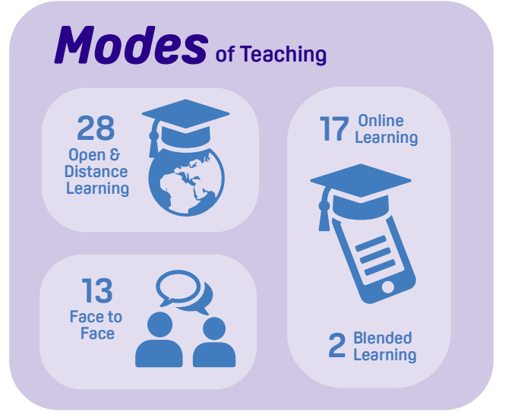
Open Universities in the Commonwealth
Key Priorities of Open Universities
Optimising Technology and ODL
Enhancing Quality Assurance
Promoting inclusivity
Internationalisation
Improving and Automizing University processes and offering
Increasing Student enrolment and success
Capacity building of faculty and Staff
Expanding and Strengthening research activities

Slide 12
Mauritian examples of Technology enabled learning

Slide 13
Futures of Higher Education 2040
The use of technology in HE
To improve teaching and learning
To improve analytics and to enable personalized student experiences
To improve IT courses (up-to-date)
Innovation in Research
Personalized learning
TECHNOLOGY
QUALITY
PATHWAYS & MOBILITY
Emerging Themes
EQUITY & ACCESS
Pathways, Mobility & Flexibility
-Flexible and personalized learning pathways
-Credit Transfer and mobility (locally and internationally)
-Modular/Remote Learning
-Connectivity (Work based learning)
SHIFTING MANDATE
INTERNATIONALISATION

Slide 14
Critical Success Factors for Technology in HE Futures of Higher Education _May 2023 Mauritius
ACCESS TO TECHNOLOGY
PEDAGOGICAL EFFECTIVENESS
FACULTY TRAINING
MAINTENANCE AND SUPPORT
COST
DATA PRIVACY AND SECURITY

Slide 15
Technology Enabled Learning in HEIs
1. Online Learning Integration
1
Baseline Study
3 surveys to evaluate the preparedness of 4 universities in Mauritius on the status of TEL strategy
HEC- ‘Guidelines for developing Institutional Technology- Enabled Learning Policy’ that allowed 4 HEIs to produce their institutional TEL strategy document
2
HEC Guidelines
Capacity Building Workshops with 40 lecturers from 4 Universities on ‘Development of Online/Blended Courses using OER
3
Capacity Building
40 Courses are being developed
Students from the 4 University will benefit from OER Courses by next semester
4
Online Courses

Slide 16
Targeted scholarships to Special Education Need Educators
2. Inclusivity and Diversity
SDG4-Ensure inclusive and equitable quality education and promote lifelong learning opportunities for all
Courses
Managing ADHD, Autism, Learning Disabilities, and Concussion in School
Diversity and Inclusion in Education
Teaching Children with Visual Impairment: Creating Empowering Classrooms
Disability Awareness and Support
Severe to Profound Intellectual Disability: Circles of Care and Education
Disability Inclusion in Education: Building Systems of Support
Higher Education Commission targeted Scholarships to 447 SEN Educators - 6 courses
Special Education Needs Authority (SENA) with the core objectives of monitoring and facilitating the implementation of special education needs policies of the Government

Slide 17
3. Employability and Workforce Alignment
COL Skills for Work Scholarships Mauritius
To enable access to high quality skill development courses provided through the world’s leading e-learning platforms, such as, Coursera and Udemy.
3,000 Scholarships
(2021- 2023)
Access to more than 10,000 courses
THREE UNIQUE CERTIFICATION PROGRAMMES

Slide 18
Policy shifts

Slide 19
Policy Shift Approaches
Online Learning Integration
1
Inclusivity and Diversity
3
Flexible Credentialing
2
Employability & Workforce Allignment
4
5
Digitalisation: Data Privacy & Security

Slide 20
National Policy examples on ODL
Vision: To be a regional centre of excellence providing all citizens, seamless equitable access to lifelong learning through open and distance learning enabling them to meet intellectual, economic, cultural and ethical challenges of the knowledge society
Key Policy Focus Area
Governance and Management
Mission: To provide increased access to higher educational opportunities and lifelong learning in an affordable and flexible manner that will equip with desired values, attitudes, knowledge, skills, and competencies to enable all citizens to realise their full potential, live and work in dignity, lead full productive lives and make informed decisions as Sri Lankans citizens and thereby contribute to national development
The Learners
Human Resource Development
Curriculum and Programme Organization
Core Values and Principles
Course Design and Development
Equity, equality and inclusiveness in access
Professionalism in the provision of ODL
Learner-centric ensuring that the learner is at centre of all academic activities
Conducive environment for quality teaching learning, research and innovation
Strong partnership with all stakeholders
To embrace change
To pursue excellence
Learner Support and Progression
Infrastructure and Learning Resources
Research
Learner Assessment and Awards
Quality Assurance and Enhancement

Slide 21
Recommended Policies
National Consultation for SADC – October 2021
Adequate assessment policies
Policy for online teaching and learning,
Academic training on ODL
ODL Policy, (Workflow and Procedures for ODL implementation
Policy for Open Educational Resources,
Technology-enabled learning policy
National level policies enabling transferability of credits and other such processes affecting open learning
Quality Assurance standards, for blended learning, use of e- pedagogy

Slide 22
Example: Policy implications for Workload Model in Open University
The workload model for open universities is based on tutoring rather than traditional academics
This staffing model offers flexibility and cost-efficiency, but it also presents certain challenges.
Full Time: 6362
3 %
Total Teachers in OUs: 252,829
97 %
Part Time: 226,140
Notes:
Oliver_Open-Universities-Commonwealth-2nd-ed

Slide 23
Policy Considerations: Tutoring-Based Model
Workload Management
Establish clear guidelines for manageable tutor-to-student ratios to prevent burnout and ensure tutors have adequate time for individualized support
To support tutoring-based teachers in open university environment, it is essential to formulate policies that cater to their distinctive requirements and difficulties.
Compensation and Benefits
Implement policies that provide competitive compensation packages and benefits for tutoring-based teachers to attract and retain qualified educators.
Professional Development
Create opportunities for ongoing professional development and training to enhance tutor effectiveness and keep them updated with best practices.
Technology Support
Provide policies and resources for technical support to assist tutoring-based teachers with any technology-related issues they may encounter.
Quality Assurance
Establish standards and procedures to ensure the quality of tutoring services, including regular evaluations and feedback mechanisms.
Accessibility
Ensure that tutoring materials and platforms are accessible to all students and tutors, including those with disabilities.
Research and Innovation
Allocate funding and resources for research and innovation in tutoring methods and technologies to enhance the overall tutoring experience.

Slide 24
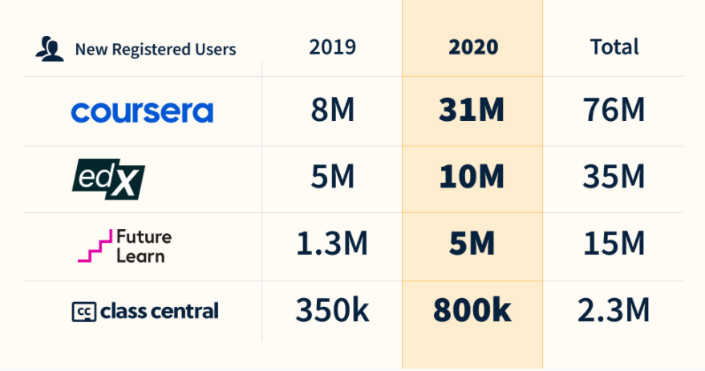
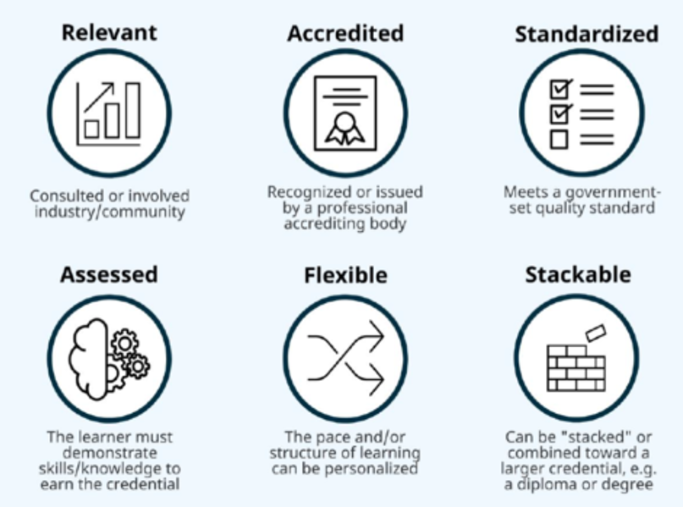
Micro Credentials in Higher Education
Microcredentials: calling for new paths, multiple streams, a wider array of credentials — so people can reskill as needed and put those skills to work immediately.
Learners need consistent upskilling throughout their lives, in a framework where more dynamic profession pathways are becoming the norm.
Markers and Benefits
Increased adoption of online distance education
Increased acceptability of online training for professional development
https://www.weforum.org/agenda/2020/10/top-10-work-skills-of-tomorrow-how-long-it-takes-to-learn-them/
Bates, T. (2021) Understanding microcredentials: A report from Heqco: Tony Bates, Tony Bates |. Available at: https://www.tonybates.ca/2021/05/31/understanding-microcredentials-a-report-from-heqco/
Llopis, G. (2022) Leading in a time of change: Higher education in transition, Forbes. Forbes Magazine. Available at: https://www.forbes.com/sites/glennllopis/2022/11/23/leading-in-a-time-of-change-higher-education-in-transition/?sh=4f05129f1459
Source: https://www.classcentral.com/report/the-second-year-of-the-mooc/

Slide 25
Establishing Policies and Practices in a Micro Credential framework
1
Quality:. Quality assurance processes must be fit-for-purpose, be clearly documented, accessible, and meet the needs of learners and stakeholders.
6
Portability:. owned by the credential-holder and may be stored and shared easily
2
Transparency: Micro-credentials are measurable, comparable and understandable with clear information on learning outcomes, workload, content, level, and the learning offer, as relevant.
7
Learner Centred: designed to meet the needs of the target group of learners.
8
Authentic: contain sufficient information to check the identity of learner, issuer, and the date and location
3
Relevance: designed as distinct, targeted learning achievements, and learning opportunities, to meet identified learning needs.
9
Learning Pathways: designed to support flexible learning pathways, including the possibility to
stack, validate, and recognise micro-credentials from across different systems
4
Valid Assessment: learning outcomes are assessed against transparent standards
5
Recognition: recognised for academic or employment purposes based on standard
recognition procedures
10
Information and guidance: Incorporated in lifelong learning guidance services and reach the broadest possible learner groups, in inclusive way
https://education.ec.europa.eu/sites/default/files/2022-01/micro-credentials%20brochure%20updated.pdf

Slide 26
Micro-credential policy requirements
Countries like the United States, Australia, and the United Kingdom have established frameworks and guidelines for recognizing and accrediting microcredentials and MOOCs within their education systems.
Recognition and Accreditation
Canada has established quality assurance mechanisms to ensure the quality and credibility of microcredentials and MOOCs. For example, Ontario's Micro-credential Framework provides guidelines for the design, development, and assessment of microcredentials.
Quality Assurance
New Zealand has implemented policies that promote flexible learning pathways and recognize microcredentials as a way for individuals to gain skills and qualifications outside of traditional degree programs.
Flexible Learning Pathways
Netherlands has integrated microcredentials and MOOCs into their professional development programs for teachers, allowing them to acquire new skills and knowledge in a flexible and accessible manner.
Professional Development
Singapore has integrated microcredentials and MOOCs into their SkillsFuture initiative, which aims to support the upskilling and reskilling of the workforce to meet evolving industry needs
Upskilling and Reskilling

Slide 27
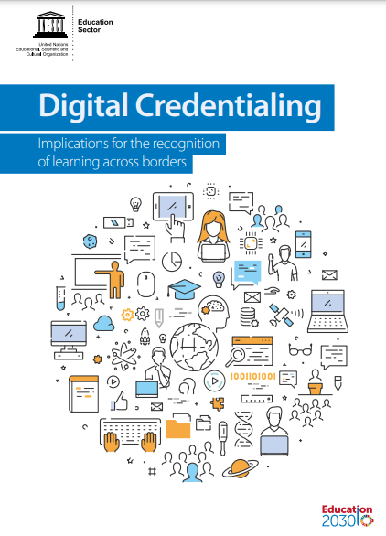
Micro-credentials Guidelines and Framework

Slide 28
Way Forward
Establishing policy guidelines and instruments for policy shifts towards new education trends

Slide 29
Thank you
Acknowledgement to V Maghoo and O Roopchand
Higher Education Commission, Mauritius
October 2030

